Slide 1


Storytelling about interdependencies

Slide 2
Summary
This teaching activity engages students in considerations on how humans and more-than-humans are interdependent. Students work with situations where interdependencies between humans and more-than-humans are present to better understand how humans might play a role in nature-cultural systems. Based on the identified situations, students create illustrated stories about how more-than-humans and humans are interdependent.
Learning outcomes
Choose what more-than-human situation to work with based on situations and related knowledge about these situations.
Find interdependencies between different human and more-than-human actors in the chosen situation.
Describe and illustrate what the interdependencies are about through storytelling tools.
Discuss what designers should pay attention to if designing with or for the situation studied.

Slide 3
Outline/Content
Care ethics and interdependencies in e.g., soil
Food web model
Considering expertise knowledge
Storyboard workshop, step 1-3

Slide 4
Key readings
Bellacasa, Maria Puig de la. (2017). Matters of care - speculative ethics in more than human worlds. University of Minnesota Press. Pages: 183-195 from section: ”From Production to Service – and Care?” to section “Making Time for Soil (Care)”
Pimm, Stuart. L., Lawton, John H., and Cohen, Joel E. (1991). Food web patterns and their consequences. Nature 350, 669-674. https://doi.org/10.1038/350669a0
Martin, Bruce and Hanington, Bella (2019) Universal methods of design: 125 ways to research complex problems, develop innovative ideas, and design effective solutions. USA: Rockport Publishers. Pages: 212-213.

Slide 5
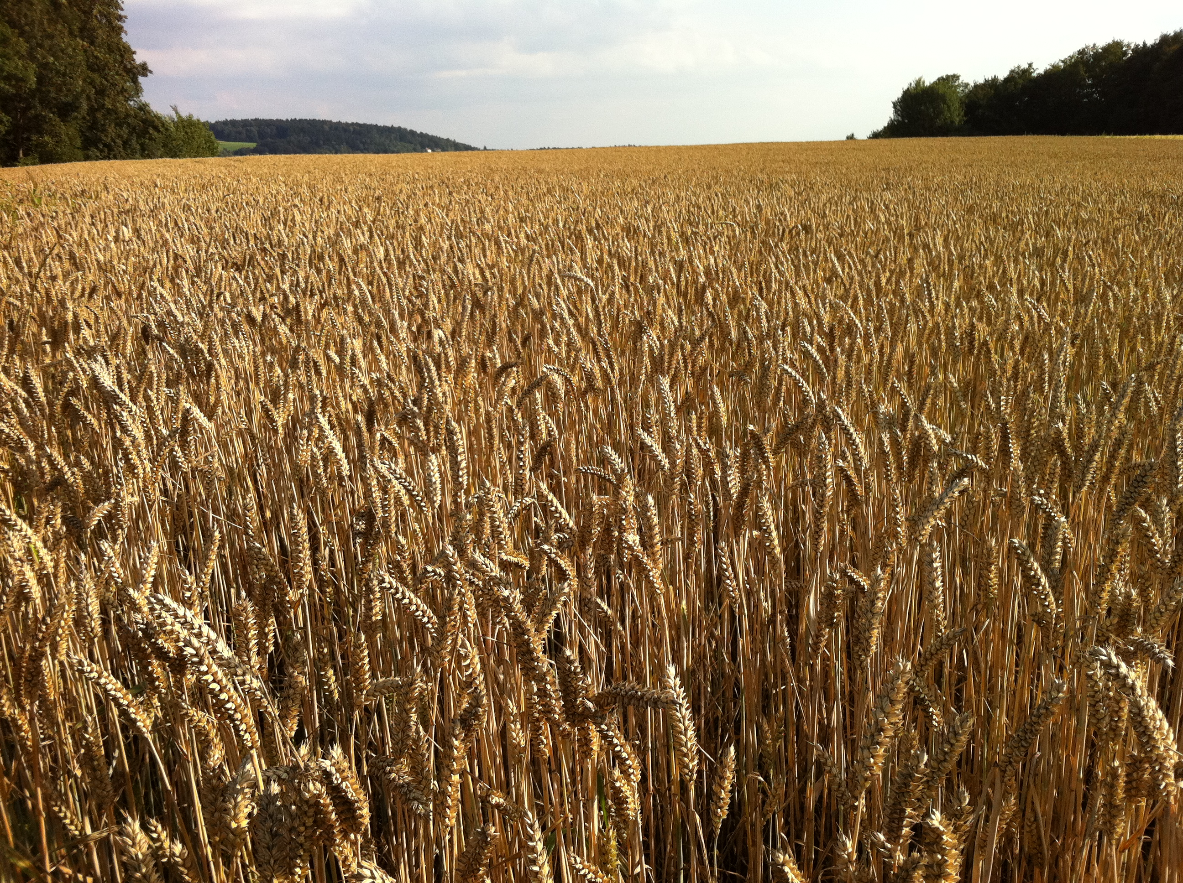
Care ethics and interdependencies in soil
Industrialization of farming: monoculture with pesticides and fertilizers. Focus on maintaining and maximizing yield instead of the soil system.
Productionism colonizes all other relations: everyday life, relations with other species, and politics (e.g., farmers’ subjection to the industry-agribusiness complex. (Bellacasa 2017, p. 184)
According to soil science we have a problem with misadjusted temporalities: between soil as a slowly renewable entity and the accelerated technological solutions required by intensified production. (Bellacasa, 2017, p. 185)
Example: farmers need to consider, and care for the ecosystem in which they grow crops. A big part of the ecosystem is the soil. The soil is a food web system that consists of fungi that maintain soil structure, and many other microorganisms. It can be depleted through industrial farming when it is plowed and fertilized, and if the crops are sprayed with pesticides.
Image source: Max Ronnersjö, A field of wheat in Deggendorf, Germany, 2011. https://commons.wikimedia.org/wiki/File:A_field_of_wheat.JPG

Slide 6
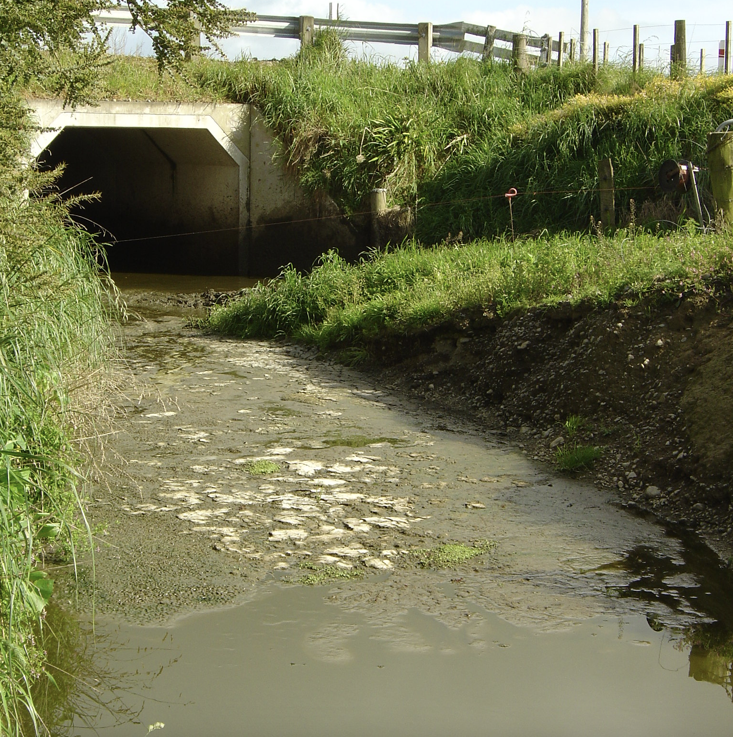
Care ethics and interdependencies in soil
Ethical issue: when care is reduced to control of the object of care, instead of being co-constructed through interdependent relations between human and more-than-humans. The background image shows water running from farming land where farmers control the crop growth with fertilizers and pesticides. Consequences are that pesticides pollute the ground water, and fertilizers increase algae growth in the oceans.
Furthermore, soil is seen as dirt. Consider soil’s (and water’s) impoverishment and exhaustion. Industrial farming aims for production at the expense of all other relations. We need to become aware of the non-human communities that are present in soil: what is it that makes soil become soil, and not dirt? This requires knowledge from experts such as soil biologists.
Eco-system services: the goods and services provided to humans by healthy wildlife and eco-systems. From a more-than-human perspective, we can critique this term because it frames the human as a "consumer" and nature as a "producer".
Image source: Alan Liefting. Wikimedia Commons. Water pollution due to diary farming in Wairapa in New Zealand. https://www.flickr.com/photos/48722974@N07/4525892268

Slide 7
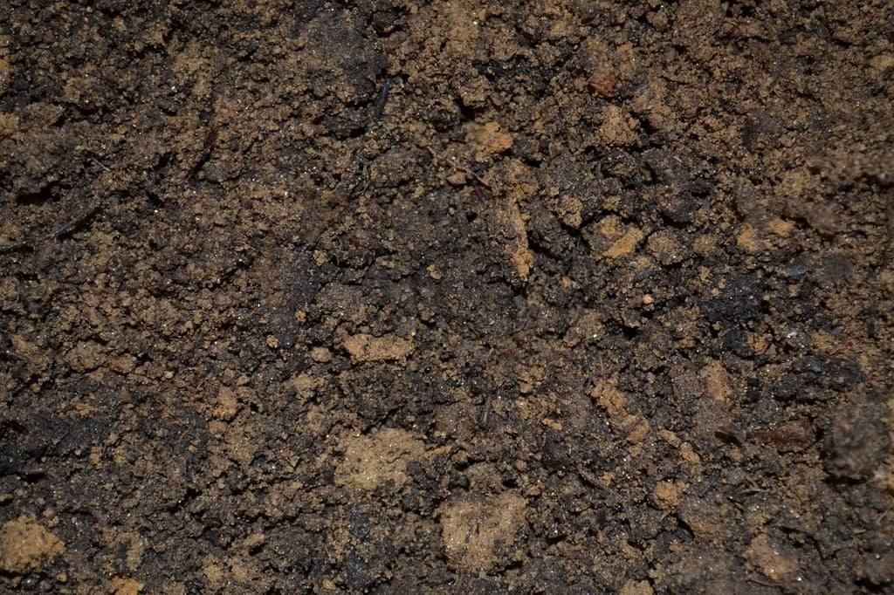
Care ethics and interdependencies in soil
Consider the multispecies communities of biota that make the soil. If they are not present in the soil, then the soil turns into dirt. There is a challenge maintaining a balance and richness of biota in the soil.
What agencies are involved in maintaining all the living beings that soil consists of?
Consider the food web: how one species’ waste becomes another species’ food. Bellacasa describes it like this:
“how the capacities of soil in food webs refer to a multilateral relational arrangement in which food, energy, and waste circulate in nonreciprocal exchanges.” (Bellacasa 2017, p. 192)
Can humans become members of the soil community? Perhaps if humans consider:
“Nature-cultural transformation in human-soil relations of care” (Bellacasa 2017, p. 194):
Image source: Pixabay.com: https://boudewijnhuijgens.getarchive.net/media/dirt-soil-potting-nature-landscapes-5bd2f9

Slide 8
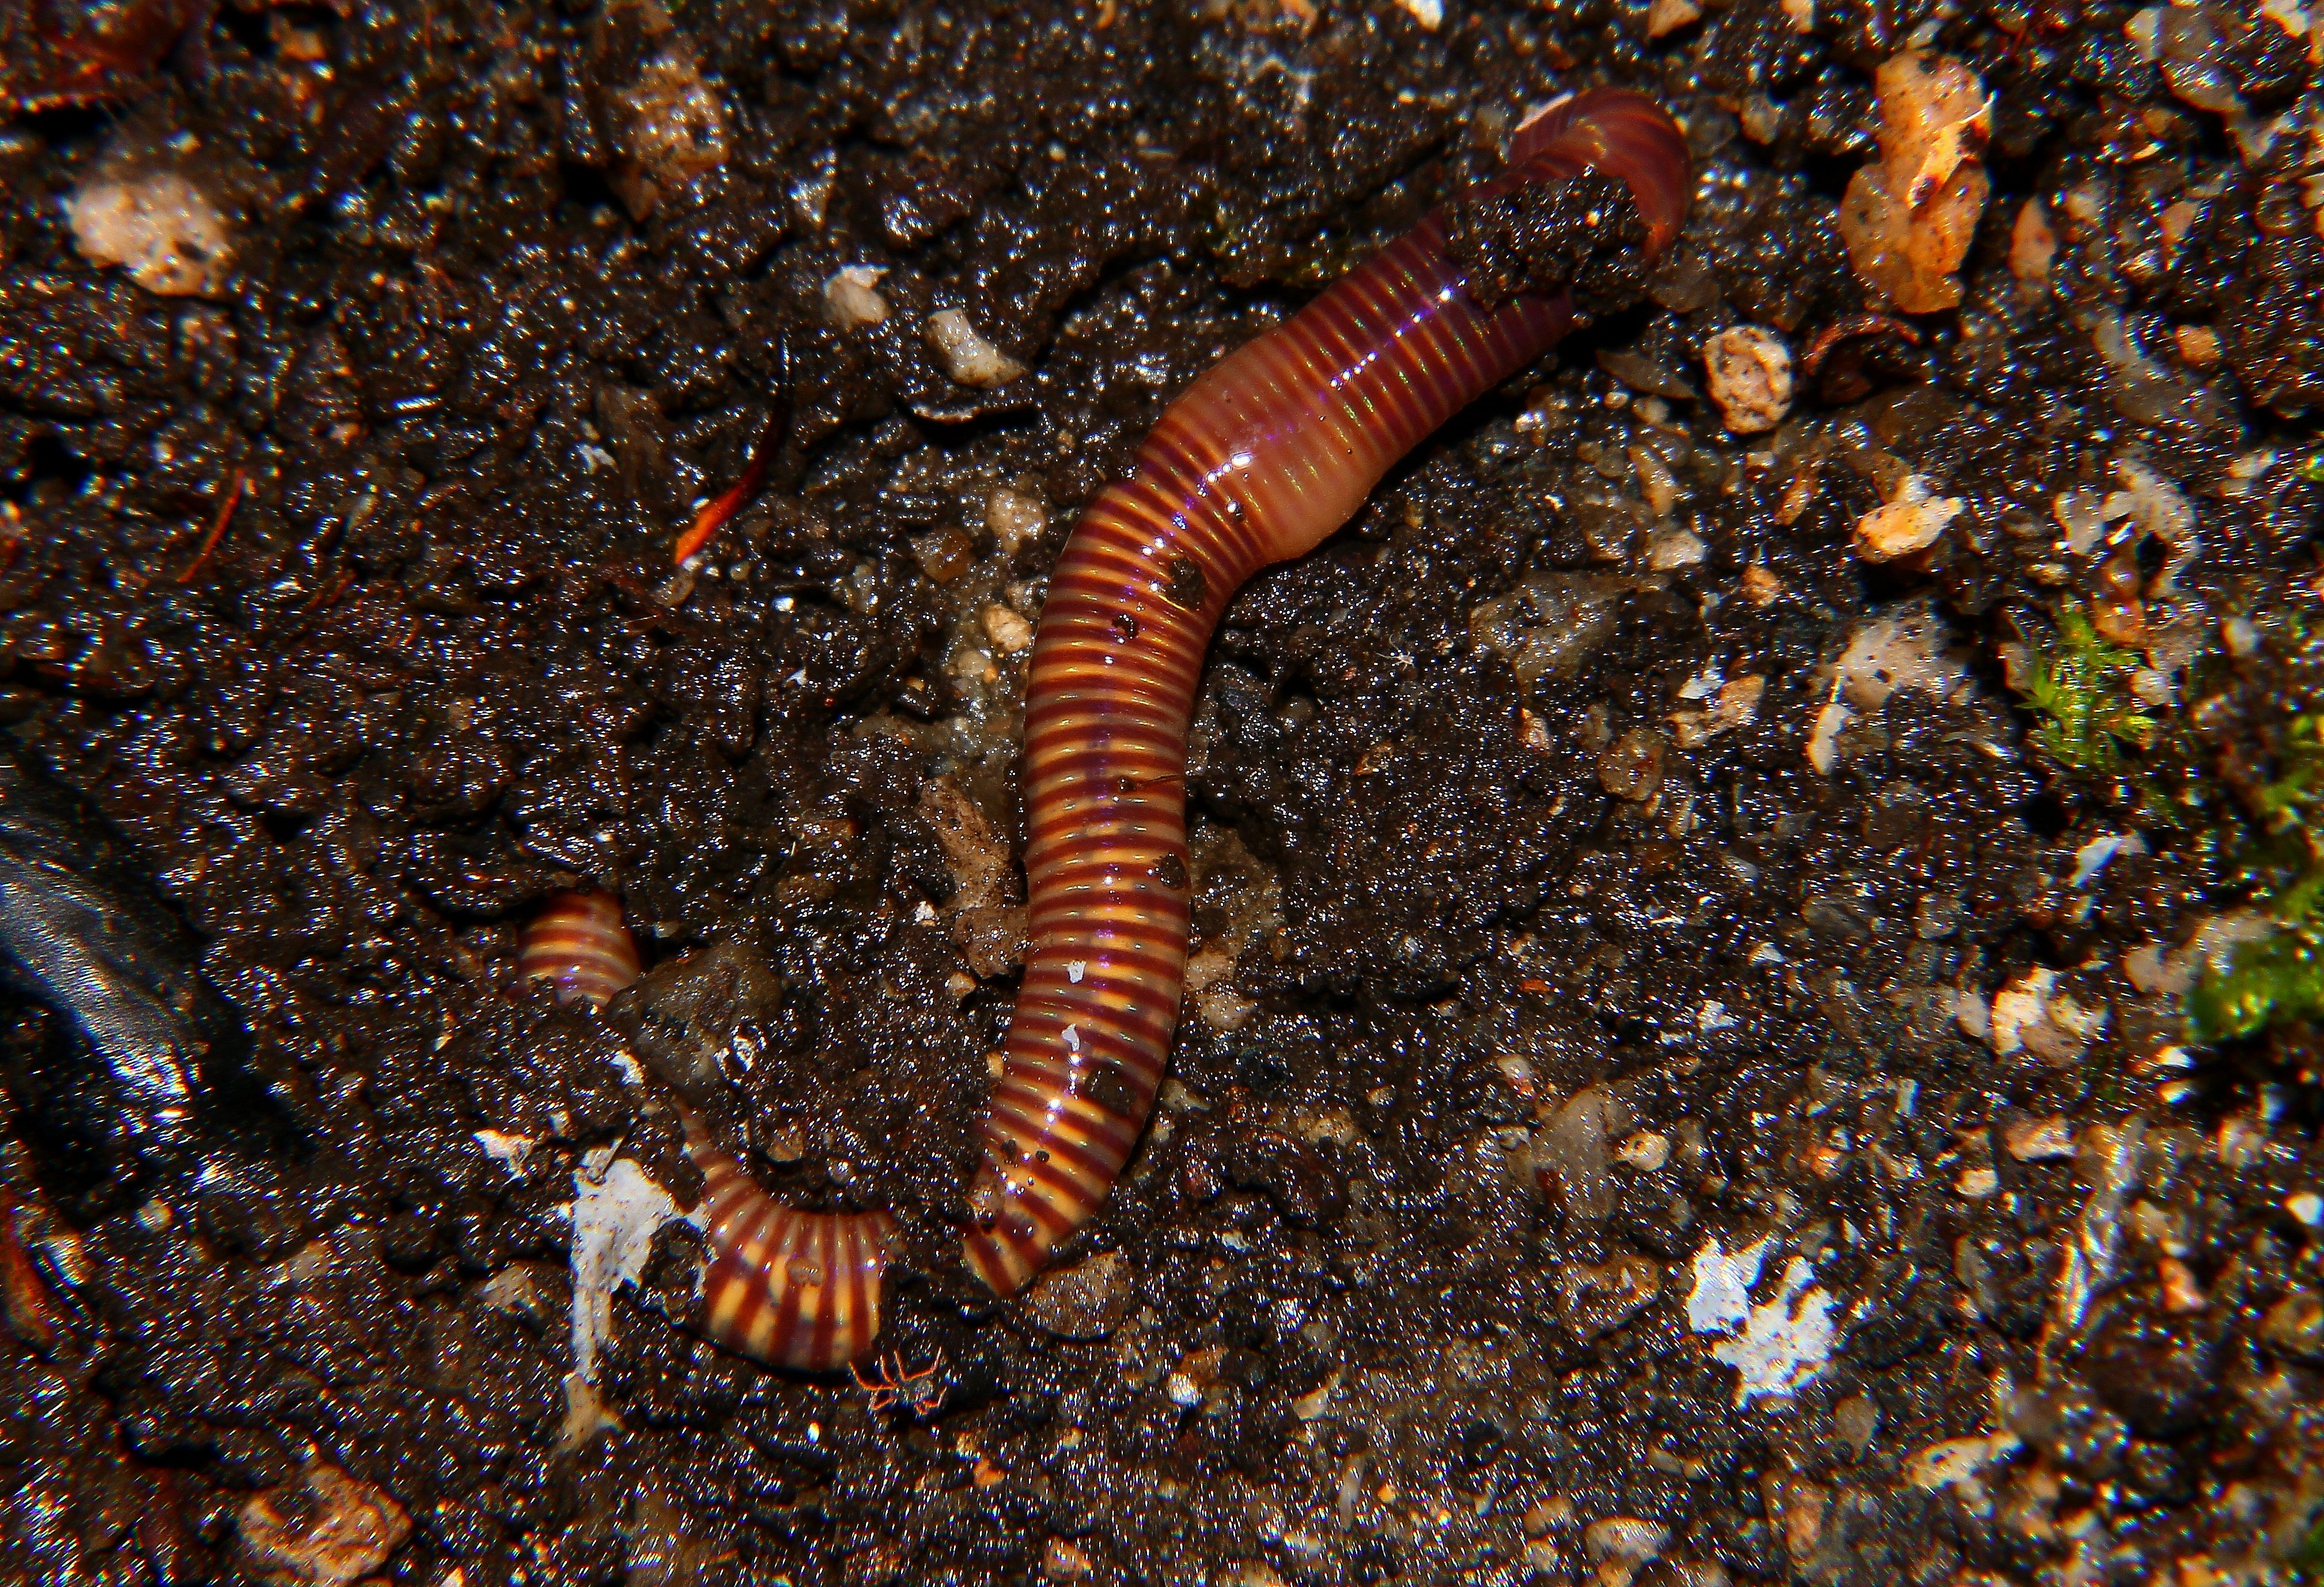
Food web model
Food webs are webs of species that are interlinked through what they eat. One species’ waste may be another species’ food. Inside the food webs there are food chains. There are also other relations such as how species might benefit from each other’s qualities and behaviors when living with one another. For example, one species provides shadow for another. In the case of soil: earth worms provide air for plant roots when moving around. They eat decaying plants and animal matter and turn them into nutritious soil.
Highly connected webs can be difficult to enter. Balances between predator and prey can be disturbed. Food chains are longer in stable systems and shorter in unpredictable systems. When one species is removed, it can put the whole system out of balance because the food chain is broken (Pimm, Lawton, and Cohen 1991).
Note: the article highlights how little humans know about the complexity of food web systems, and how much we still need to investigate.
Image source: Gabriel Conzález: https://pxhere.com/en/photo/305259

Slide 9
Considering expertise knowledge
Who might designers learn from when designing for/with more-than-humans?
Biologists, zoologists, botanists, environmental scientists … fields inside nature science:
What species are part of the ecosystems that you work with?
What elements in these eco-systems do the species relate to?
Understanding how the species relate to one another through food webs and other qualities and characteristics in the environment over time and space.
How are members of an ecosystem interdependent? What species are particularly important in a food web?
How do human activities and presence affect food webs and eco-systems?

Slide 10
Considering expertise knowledge
Who might designers learn from when designing for/with more-than-humans?
Ethnography and anthropology, traditional knowledge and Indigenous knowledge … fields inside the humanities:
What kinds of understandings are there in traditional and Indigenous cultures of the ecosystem that you work with?
What kinds of human experiences interacting with the environment generated these understandings?
How are these understandings conveyed? (For example, through myths, storytelling, cultural activities like singing and dancing, language and naming of things etc.)

Slide 11
Considering expertise knowledge
Who might designers learn from when designing for/with more-than-humans?
Local people – typically older people whose professions and ways of life are entangled with the natural environment to a high degree:
What do local people know about the ecosystem that you investigate and design for/with?
What kinds of everyday activities performed by local people are informed by the ecosystem that they are surrounded by?
Have the local people already developed some ways of living-with local more-than-humans? If yes, in what ways? If no, why not? What prevents them from doing this?

Slide 12
Storytelling workshop, step one
Work together in groups with a selected ecosystem. It can be the ecosystem that is part of the project that you work on in the course. You can also just pick a local ecosystem. Find out who the different more-than-human actors are in the ecosystem that you investigate.
Investigate further through desktop research how these actors are interdependent. When being interdependent of each other, actors rely on each other for survival. For example, one species’ waste material becomes someone else’s food, or something else useful for them.
If you cannot find this information, then consider where you find the expertise.
From what you learn, you can draw a map of interdependencies between the actors in the investigated eco-system.

Slide 13
Storytelling workshop, step two
When you learned about some interdependencies, draw storyboards or other illustrated descriptions where you show-and-tell how a selection of more-than-humans are interdependent of each other.
An illustration can for example be of how plant roots and fungi rely on each other for nutrition.
You should somehow illustrate how humans and more-than-human actors in an ecosystem are interdependent. For example, you can illustrate behaviors and qualities that show interdependence. Provide narratives that illustrate the knowledge that you have gathered.

Slide 14
Storytelling workshop, step three
At the end of the workshop, we will present the illustrated storyboards to each other in the classroom.
A storyboard is like a comic strip where you illustrate a narrative experienced by one or more actors. A good length of a story could be just five images. It is also nice to have a few lines of explanation under each image to give the viewer an idea of what is happening in each image. Please visit this website to find storyboard templates that you can print and use: https://boords.com/storyboard-template
You can also share with us where you gathered the information. What information you lack, and who you consider to talk to to gather the missing information and knowledge.
An alternative to consulting with experts could be to do your own field studies. Where would you go? How would you gather the information that you need?
After this sharing, we will discuss what designers should pay attention to if designing with or for the situation studied.

Slide 15
Reflections while telling stories
How might humans become part of the soil community, the ocean community, or another community?
When becoming aware of how things are interdependent in a local eco-system, how might humans live-with these ecosystems in ways that regenerate them instead of damaging them?
Are there also technological more-than-humans that could be part of these eco-systems that humans can employ to better live-with an ecological environment?
What kinds of old nature-cultures (Haraway 2016) exists already where humans have developed ways of living with the local eco-system?
And can we develop new nature-cultures that encourage people to live-with the current ecosystems and even regenerate elements of them?
Haraway, Donna (2016) Staying with the trouble – making kin in the Chthulucene. Duke University Press.

Slide 16
References
Bellacasa, Maria Puig de la. (2017). Matters of care - speculative ethics in more than human worlds. University of Minnesota Press. Pages: 183-195 from section: ”From Production to Service – and Care?” to section “Making Time for Soil (Care)”
Haraway, Donna (2016) Staying with the trouble – making kin in the Chthulucene. Duke University Press.
Martin, Bruce. and Hanington, Bella (2019) Universal methods of design: 125 ways to research complex problems, develop innovative ideas, and design effective solutions. USA: Rockport Publishers. Pages: 212-213.
Pimm, Stuart. L., Lawton, J. H. and Cohen, J. E. (1991). Food web patterns and their consequences. Nature 350, 669-674. Doi: https://doi.org/10.1038/350669a0

Slide 17
This teaching activity was developed as part of the MOVA project co-funded by the European Union. https://mova.uni.mau.se/
Disclaimer: Funded by the European Union. Views and opinions expressed are however those of the author(s) only and do not necessarily reflect those of the European Union or the European Education and Culture Executive Agency (EACEA). Neither the European Union nor EACEA can be held responsible for them.

