Slide 1


Social practice theory as a more-than-human design perspective

Slide 2
Summary
In this activity, you will be introduced to social practice theory and how to apply this as an analytical lens to understand the dynamic nature of everyday life. Social practice theories represent a particular way of understanding culture, society, everyday life, and material/resource consumption.
Framing social practice as a unit of analysis allows us to recognise the relational configurations of practices that include nonhuman entities, materials and performers of these practices. We further introduce how social practices can be framed as our unit for design.
Learning outcomes
After the teaching activity students should be able to:
Identify everyday practice elements as configurations of meaning, material and competencies.
Reflect on the environmental impacts and the roles of nonhuman elements shaped by social practice.
Identify potential design ideas that may trigger reconfigurations of practice, focusing on a holistic understanding of meaning, material, and competencies.

Slide 3
Outline/Content
1st lecture part
  Social practice theory
  Elements of practice
  Practice as a unit of analysis
  Practice and more-than-human
1st exercise
2nd lecture part
  Design as change
  Practice as a unit of design
  Design triggers
2nd exercise

Slide 4
Key readings
Chapter 1 & 2: Shove, E., Watson, M., & Pantzar, M. (2012). The dynamics of social practice: Everyday life and how it changes. Sage Publishing.
Kuijer, L., De Jong, A., & Van Eijk, D. (2013). Practices as a unit of design. ACM Transactions on Computer-Human Interaction, 20(4), 1–22. https://doi.org/10.1145/2493382

Slide 5
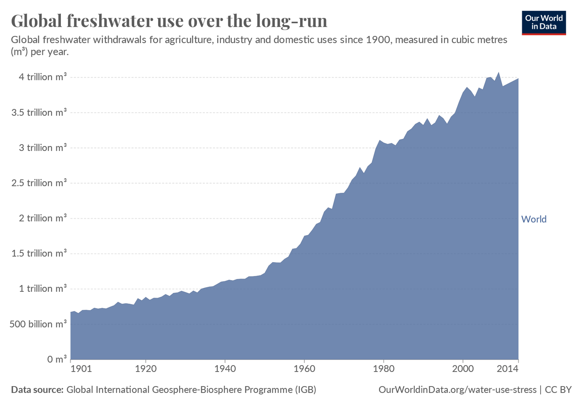
Changes in resource consumption over time
Image and data by OurWorldinData | CC BY
https://ourworldindata.org/water-use-stress

Slide 6
… How can we understand this change over time and how it shapes resource consumption?
Practice as a unit of analysis

Slide 7
Why social practice theory?
DECENTERING THE HUMAN….
By embedding non-human elements into the analysis of practices, social practice theory inherently de-centers the human, offering a more holistic understanding of social phenomena.
This perspective is particularly valuable for addressing complex, environmental, multi-species, and ecological challenges.
Social practice theory de-centers the human by shifting the focus from individual actors to everyday practices (showering, cleaning, cooking, etc.). This framework inherently incorporates non-human elements, recognising their active role in shaping social practices.
Introduction to the special issue on practice-oriented approaches to sustainable HCI (Pierce et al., 2013)

Slide 8
Social Organisation
…. different forms of explaining action, social order, and changes in our society
Toward a Theory of Social Practices: A Development in Culturalist Theorizing (Reckwitz, 2002)

Slide 9
Theory of Social Practices
…. represents a particular way of understanding society and everyday life: a way that takes practices as the fundamental and smallest unit of social analysis
Toward a Theory of Social Practices: A Development in Culturalist Theorizing (Reckwitz, 2002)

Slide 10
What is practice?
“a routinised type of behaviour which consists of several elements, interconnected to one other:
forms of bodily activities, forms of mental activities, ‘things’ and their use, a background knowledge in the form of understanding, know-how, states of emotion and motivational knowledge”
Toward a Theory of Social Practices: A Development in Culturalist Theorizing (Reckwitz, 2002)

Slide 11
Elements of Practice
Configurations of elements
Competence
Material
Meaning
The dynamics of social practice: Everyday life and how it changes (Shove et al. 2012)

Slide 12
Learned bodily routines, skills, know how, and ways of feelings
Elements of Practice
Competence
Cultural conventions, expectations, and social shared ideas and meaning
Material
Meaning
Ecologies of things, infrastructures, environ-ments, nonhumans, bodies
The dynamics of social practice: Everyday life and how it changes (Shove et al. 2012)

Slide 13
How to soap. Appropriate frequencies for washing. Ways of feeling clean or/and dirty
Showering as a Practice
Competence
Private time, getting clean, waking up, getting warm, relax….
Material
Meaning
Showerheads, taps, water,
soaps, drains, towels, hair, pets, “dirt”, germs, and bathrooms
The dynamics of social practice: Everyday life and how it changes (Shove et al. 2012)

Slide 14

How practices change: Elements shape each other
Re-configurations of elements
Competence
Material
Meaning
The dynamics of social practice: Everyday life and how it changes (Shove et al. 2012)

Slide 15
How practices change: Elements change over time
Meaning 1
Meaning 2
Material 1
Material 2
Competence 1
Competence 2
Elements change over time and re-configure practice
The dynamics of social practice: Everyday life and how it changes (Shove et al. 2012)

Slide 16
How practices change: Elements between practices
Repairing
Material
Driving
Competence
Meaning
Meaning of driving is often associated with masculinity and hence with other practices including those of repair
Competence
Material
The dynamics of social practice: Everyday life and how it changes (Shove et al. 2012)

Slide 17
Practice as a unit of analysis
A single individual - as a bodily or mental agent - acts as a carrier or performer of a practice
This individual is a carrier of patterns of bodily behaviour, but also of certain routinised ways of understanding, knowing how, and desiring.
Social conventionalised ”mental” activities of understanding, knowing how, and desiring are necessary elements and qualities of a practice in which the single individual participates, and not qualities of the individual.
Toward a Theory of Social Practices: A Development in Culturalist Theorizing (Reckwitz, 2002)

Slide 18
Practice and more-than-human
Material Elements:
Social practice theory includes non-human material elements (e.g., tools, technologies, natural resources) as integral to practices, shaping how routines are performed.
For instance, water availability affects showering practices, entangling natural resources directly with human actions.
Performers and Co-Performers:
More-than-human entities, like animals, machines, and AI, act as performers or co-performers of social practices, participating actively rather than serving as passive backdrops.
In the home, for example, smart thermostats perform the practice of heating, illustrating shared performances between humans and non-humans in shaping routines and consumption outcomes.
Co-performance: Conceptualizing the role of artificial agency in the design of everyday life (Kuijer & Giaccardi, 2018)

Slide 19
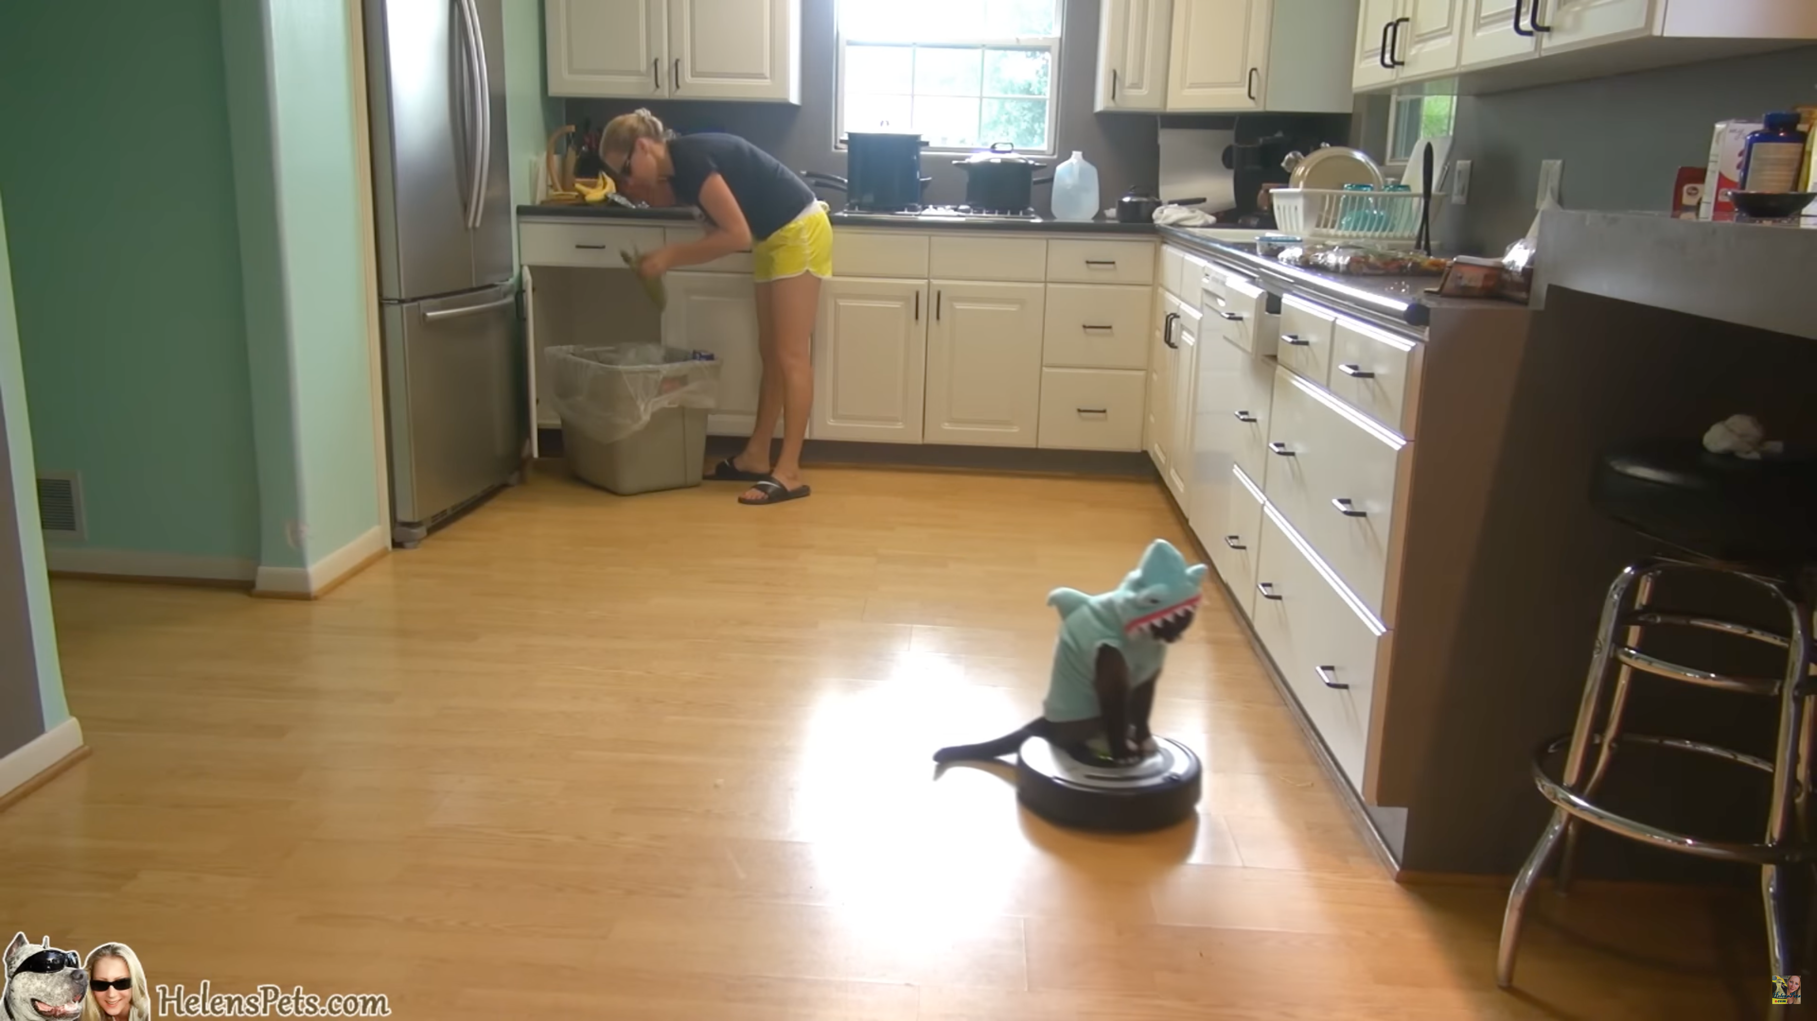
Roombas and Roomba Riders
Roombas, the popular robotic vacuum cleaners, have become integral to domestic cleaning practices with their intelligent navigation and automatic dirt detection. As both material elements and performers in cleaning practices, they autonomously sweep up dust, pet hairs, and other “domestic dirt”, making them a desirable “thing” in many households. Beyond their practical function, Roombas have become famous for another role: entertaining pets, especially cats.
Some cats, famously dubbed "Roomba Riders," sit atop these robots as they roam around, creating a playful mix of technology and pet entertainment. Here, cats and Roombas co-perform an unlikely routine—while Roombas clean floors, the cats "ride" along, adding a quirky, entertaining layer to the technology's domestic role. This unintended interaction highlights the adaptability of household technologies, merging meanings of cleanliness with enjoyment as they integrate with the home’s living, more-than-human environment.
https://www.youtube.com/watch?v=tLt5rBfNucc
Robots and Roomba riders: non-human performers in theories of social practice (Strengers 2019).

Slide 20
Roombas and Roomba Riders
However, the sustainable impacts of desirable smart-home technology like Roombas reveal complex, sometimes unsustainable outcomes. While desired because of their eco-friendliness and energy efficiency, these devices often contribute to an overall increase in household energy use due to the convenience and comfort they offer, encouraging, e.g., more frequent use. For instance, Roombas and similar automated devices require consistent charging, depending on usage; pet entertainment may create demand for constant connectivity or further automation in the home, leading to a larger environmental footprint.
https://www.youtube.com/watch?v=tLt5rBfNucc
Designing the desirable smart home: A study of household experiences and energy consumption impacts (Jensen et al., 2019).

Slide 21
Group Work 1

Slide 22
1: Describe
Choose a practice from your everyday life that you are familiar with.
Describe the chosen practice based on the three elements: materials, meaning, and competencies.
Feel free to draw a picture if it helps you.
2: Reflect
Reflect on the resource consumption associated with this practice.
Reflect on the more-than-human elements and/or performers involved in this practice.
3: Design
Consider what changes would be required in the three elements—materials, meaning, and competencies—to make it both meaningful and sustainable.
Feel free to draw a picture of a future situation where and how this new practice may be performed.

Slide 23
… However, making practice as a unit of analysis does not in itself lead to interaction design ideas or change…

Slide 24
… How can we then design for change?
Practice as a unit of design

Slide 25
Practice as a unit of design
“In practice-oriented design, the unit of design expands from things to include meanings and competences, but not without consideration of how these fit together.”
Practices as a unit of design
(Kuijer et al., 2015)

Slide 26
Practices as a unit of analysis
Opportunities for meaningful and desirable change
Practices as a unit of design
Suggest a trigger
Facilitate performances
Combine, evaluate and refine
Reconfigurations that work
Implications of Social Practice Theory for Sustainable Design (Kuijer, 2014)

Slide 27
Design as triggers
A design trigger:
Is not itself “thought to be a ‘sustainable innovation’ or a ‘solution’ to achieve reduced” consumption, but seen as triggers for playing out different practice configurations
Can explore what types of uses would emerge and how these may fit in or conflict with existing practices
Can trigger a variety of bodily responses and the evaluative reflections they evoke.
Suggest a trigger
Facilitate performances
Combine, evaluate and refine
Practices as a unit of design
(Kuijer et al., 2015)

Slide 28
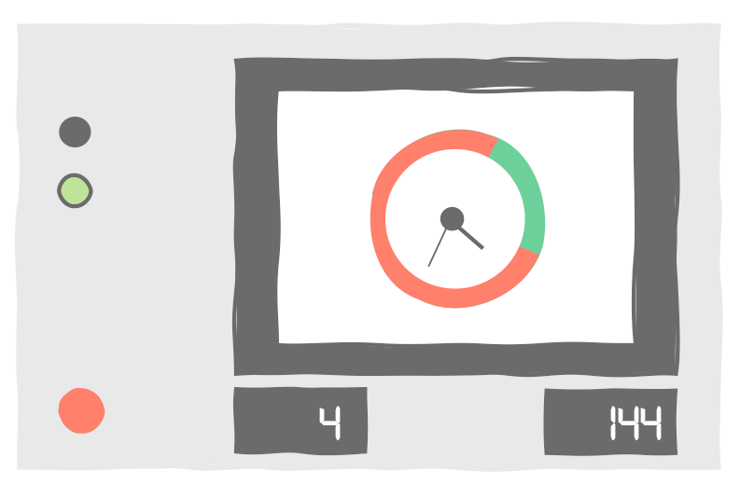
An example: laundry as a practice
How do we use renewable energy to do laundry?
What time of day should we wash, then?
How do we change routines?
Competence
Meaning
Image by Rikke Hagensby Jensen
Something we do together
Fun to do laundry
How often do we need to change clothes now that it’s being washed with “green” energy?
Digital energy information
Smart plugs
Artificial intelligence
Material
Washing with the Wind: A Study of Scripting towards Sustainability (Jensen et al. 2018)

Slide 29
Group Work 2

Slide 30
1: Describe
Return to the practice you described earlier.
How can design play a role in triggering more meaningful and sustainable future performances of this practice?
Consider all three elements —materials, meaning, and competencies
Feel free to draw a picture if it helps you.
2: Reflect
Reflect on both sustainable and unsustainable outcomes associated with this future practice.
Reflect on the more-than-human elements and/or performers involved in this practice.
3: Design
Sketch how such a design trigger could materialise in a situated context and how practices in this context could be (co-)performed.
Feel free to draw a picture of a situation where and how this trigger may shape the performance of this practice.

Slide 31
References
Shove, E., Watson, M., & Pantzar, M. (2012). The dynamics of social practice: Everyday life and how it changes. Sage
Kuijer, L., De Jong, A., & Van Eijk, D. (2013). Practices as a unit of design. ACM Transactions on Computer-Human Interaction, 20(4), 1–22. https://doi.org/10.1145/2493382
Kuijer, L., & Giaccardi, E. (2018). Co-performance: Conceptualizing the role of artificial agency in the design of everyday life. In Proceedings of the 2018 CHI Conference https://doi.org/10.1145/3173574.317369
Pierce, J., Strengers, Y., Sengers, P., and Bødker, S. 2013. Introduction to the special issue on practice-oriented approaches to sustainable HCI. ACM Trans. Comput.-Hum. Interact. 20, 4, Article 20 (September 2013) http://dx.doi.org/10.1145/2494260
Reckwitz, A. (2002). Toward a theory of social practices: A development in culturalist theorizing. European journal of social theory, 5(2), 243-263. https://doi.org/10.1177/1368431022222543
Kuijer, L. (2014). Implications of social practice theory for sustainable design. Delft University of Technology.
Strengers, Y. (2019). Robots and Roomba riders: non-human performers in theories of social practice. Social practices and dynamic non-humans: Nature, materials and technologies, 215-234.
Jensen, R. H., Strengers, Y., Kjeldskov, J., Nicholls, L., & Skov, M. B. (2018, April). Designing the desirable smart home: A study of household experiences and energy consumption impacts. In Proceedings of the 2018 CHI Conference on Human Factors in Computing Systems (pp. 1-14). https://doi.org/10.1145/3173574.3173578
Jensen, R. H., Raptis, D., Kjeldskov, J., & Skov, M. B. (2018). Washing with the Wind: A Study of Scripting towards Sustainability. Proceedings of the 2018 Designing Interactive Systems Conference. https://doi.org/10.1145/3196709.3196779

Slide 32
This teaching activity was developed as part of the MOVA project co-funded by the European Union. https://mova.uni.mau.se/
Disclaimer: Funded by the European Union. Views and opinions expressed are however those of the author(s) only and do not necessarily reflect those of the European Union or the European Education and Culture Executive Agency (EACEA). Neither the European Union nor EACEA can be held responsible for them.

