Slide 1


More-than-human stakeholder mapping

Slide 2
Summary
This activity will broaden your perception of what stakeholders affect or are affected by a design or a design process – beyond human actors.
You will develop an understanding of human entanglement with the world as complex socio-ecological-technological systems. You will also learn about the difference between direct and indirect stakeholders and identify and map human and more-than-human stakeholders of a design.
Learning outcomes
After the teaching activity students should be able to:
understand human entanglement with the world as complex socio-ecological-technological systems consisting of human and more-than-human stakeholders,
know the difference between indirect and direct human and more-than-human stakeholders,
identify multiple human and more-than-human stakeholders of a design and/or design process.

Slide 3
Content
Human entanglement with the world
Direct and indirect stakeholders
Human and more-than-human stakeholder mapping
Empathise with a selection of more-than-human stakeholders

Slide 4
Key readings
Fuchsberger, Verena, and Frauenberger, Christopher (2023). Doing responsibilities in entangled worlds. Human–Computer Interaction, https://doi.org/10.1080/07370024.2023.2269934
Haraway, Donna (2015). Anthropocene, Capitalocene, Plantationocene, Chthulucene: Making Kin. Environmental Humanities 6, 1, 159–165. https://doi.org/10.1215/22011919-3615934
Notes:
Recommended readings to the students to prepare for the activity.

Slide 5
The Anthropocene (/ˈænθrəpəˌsiːn, ænˈθrɒpə-/ AN-thrə-pə-seen, an
THROP-ə-) is a proposed geological epoch dating from the
commencement of significant human impact on Earth's geology and
ecosystems, including, but not limited to, human-caused climate change.
The term is used to illustrate the profound impact of human activities
such as industrialization, urbanization, and climate change on the
Earth’s systems.
Crutzen, Paul J. (2006). The “Anthropocene”. In Earth System Science in the Anthropocene.
Springer-Verlag, 13–18.

Slide 6
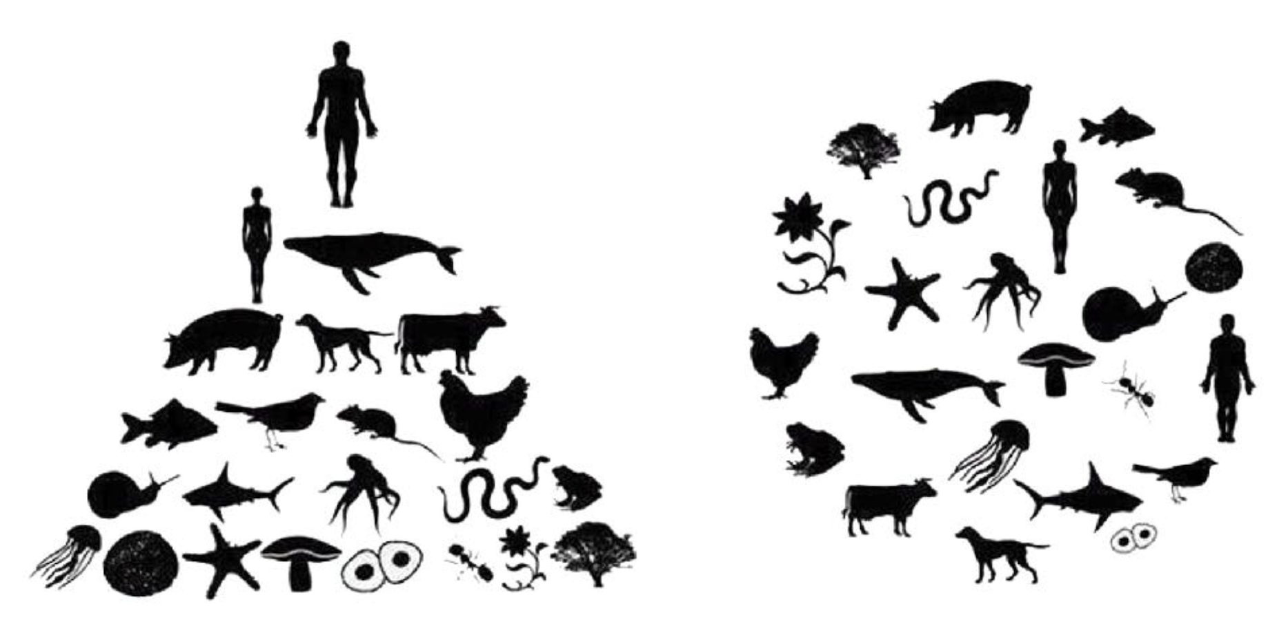
Lien, Marianne Elisabeth and Pálsson, Gisli (2021). Ethnography Beyond the Human: The ‘Other-than-Human’ in Ethnographic Work. Ethnos, 86(1), p. 1-20.

Slide 7
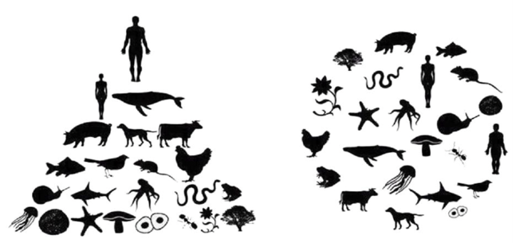
We need to learn to run human activities in other ways to not terminate​ humankind by destroying the ecological systems that we are so intimately intertwined with and dependent on. ​
How can we reframe what it means to be human and leave the idea of the human as an independent and superior part standing at the top of a hierarchy (as in​ the image on the left)? ​
How can we learn to view the human as part of a system consisting
of human and non-human parts inside and outside the
body and as part of a system of​ biological parts and
technical units (as in the image on the right)?​​
Lien, Marianne Elisabeth and Pálsson, Gisli (2021). Ethnography Beyond the Human: The ‘Other-than-Human’ in Ethnographic Work. Ethnos, 86(1), p. 1-20.

Slide 8
Entanglement theories
'Humans are intricately entangled with our world, up to the points where it makes little sense to ask where human ends and the world begins.'
Van Dijk (2021), Entanglement design, https://www.4tu.nl/du/columns/entanglement-design (Accessed on 2025-01-30)
Entanglement theories:
look upon the human and the world as intimately entangled, interconnected and intertwined. According to this view, humans are entangled with the world and dependent on all beings and entities to function.
build on the idea that interactions between humans, nature, and technology are complex and interconnected. It is argued that the relationship between humans, more-than-humans, nature and technology is not linear but a dynamic, complex web of connections and influences.
Designers who assume this view and look upon their users an themselves as entangled with the world, create more holistic and interconnected design solutions that consider the various entangled factors at play.

Slide 9
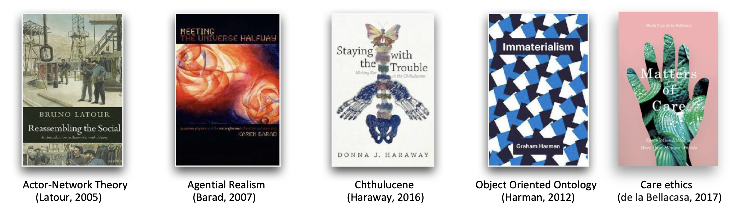
Entanglement theories
Fuchsberger, Verena, and Frauenberger, Christopher (2023). Doing responsibilities in entangled worlds. Human–Computer Interaction, https://doi.org/10.1080/07370024.2023.2269934
Haraway, Donna (2015). Anthropocene, Capitalocene, Plantationocene, Chthulucene: Making Kin. Environmental Humanities 6, 1, 159–165. https://doi.org/10.1215/22011919-3615934

Slide 10
Direct and indirect stakeholders of design
All design projects have stakeholders, but who/what can be defined as a stakeholder?
– A stakeholder is 'anyone, who will be affected, directly or indirectly, by the new system [design]'. (Friedman and Hendry, 2019, p. 36).
Direct stakeholders are thoses who directly interact with the system.
Indirect stakeholders are thoses who, although they never interact with the systems, nevertheless are affected by the system.
Friedman, B., & Hendry, D. G. (2019). Value sensitive design: shaping technology with moral imagination. MIT Press.

Slide 11
Direct and indirect stakeholders of design
Direct stakeholder: those who directly interact with the design (e-g., someone using a phone)
Indirect stakeholders: those who may be affected by a design, but without directly using it (e.g., listening to someone talking on the mobile phone).
Stakeholders can be humans or more-than-humans: individuals, groups, neighbourhoods, communities, organizations, institutions, societies, past and future generations, animals, nature, fungi, bacteria etc.
Stakeholders are defined by and understood in relation to their interaction with the design – that is, stakeholders are considered by their roles, rather than as a “being/entity”.
The same stakeholder can have multiple roles in different situations.
  For example, in one situation a stakeholder is a user that peak on a mobile phone, and at another situation be a bystander to the same technology, for example, sitting next to someone speaking on a mobile phone.
  They are affected by the same technology, the mobile phone, but in different ways depending upon their roles (an active user, or as a bystander).
  The active user is a direct stakeholder of the design – and the bystander is an indirect stakeholder.

Slide 12
If we look upon humans as intimately entangled with the world and all the more-than-human actors they we are interconnected with and interdepended by:
Who are we designing for?
Whose values and needs are to be taken into account?
Who/what else do you think would care about your design and why?
Question the notion of human-centredness
… to be human is to be more-than-human.

Slide 13
Who are we designing for?
Whose values and needs are to be taken into account?
Who/what else do you think would care about your design and why?
'Those who are or will be significantly implicated by the design.' (Friedman and Hendry, 2019, p. 36)
There might be direct target groups consisting of humans or more-than-humans, but beyond that, there are also indirect target groups that are affected and influenced by the design
Designers tend to focus only on the end-users of a designer and overlook others (beings or entities) that do not interact directly with the design but are still affected by it.
If we only think of stakeholders in terms of direct users of our designs, we might end up focusing on short-term goals and we might even unintentionally create designs that do more harm than benefit for both direct and indirect stakeholders.

Slide 14
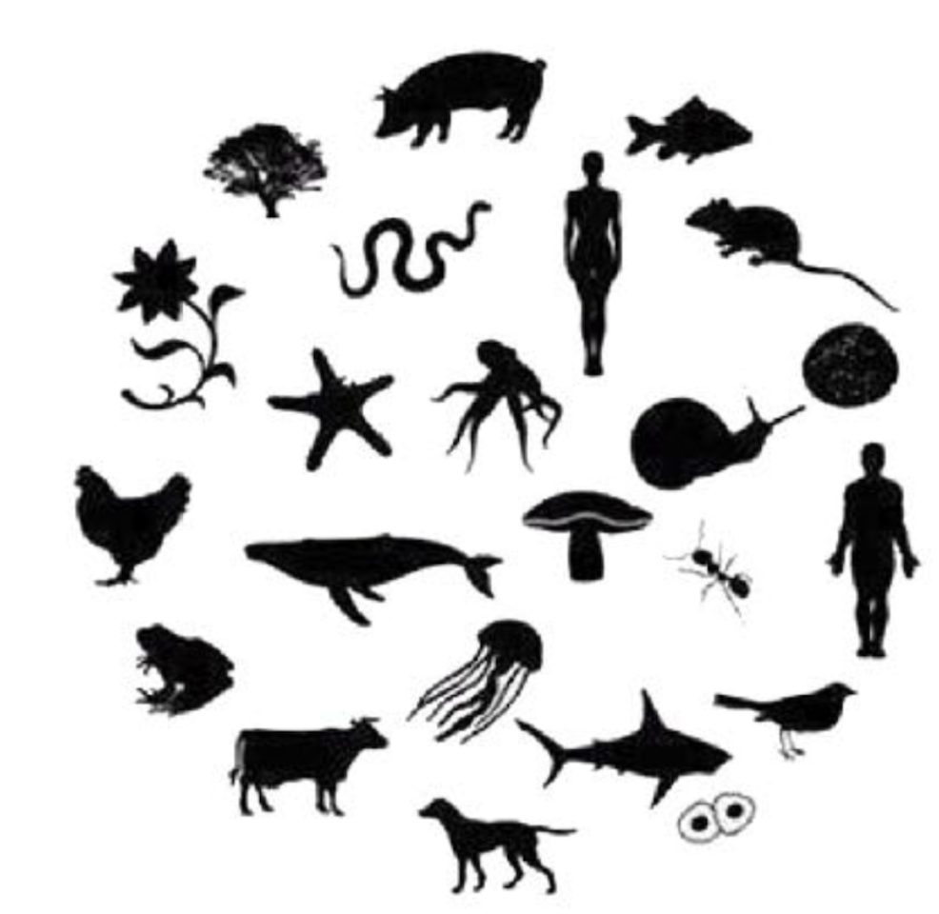
Assignment: Stakeholder mapping
Identify humans and more-than-human stakeholders
that are directly or indirectly implicated by your design.
Part I: Identify (30 minutes)
– Who/what are we designing for?
– Whose values and needs are to be taken into account?
– Who/what else do you think would care about your design and why?
Instructions:
– Brainstorm stakeholder candidates. First individually for 10 minutes then in your groups. Take notes.
– When you are done brainstorming, go through all notes and delete duplicates,
possibly rename. Place the stakeholders on a big piece of paper (or a shared digital whiteboard) in relation to each other and (maybe) draw lines between stakeholders that are directly related.
– Use 30 minutes for the activity.

Slide 15
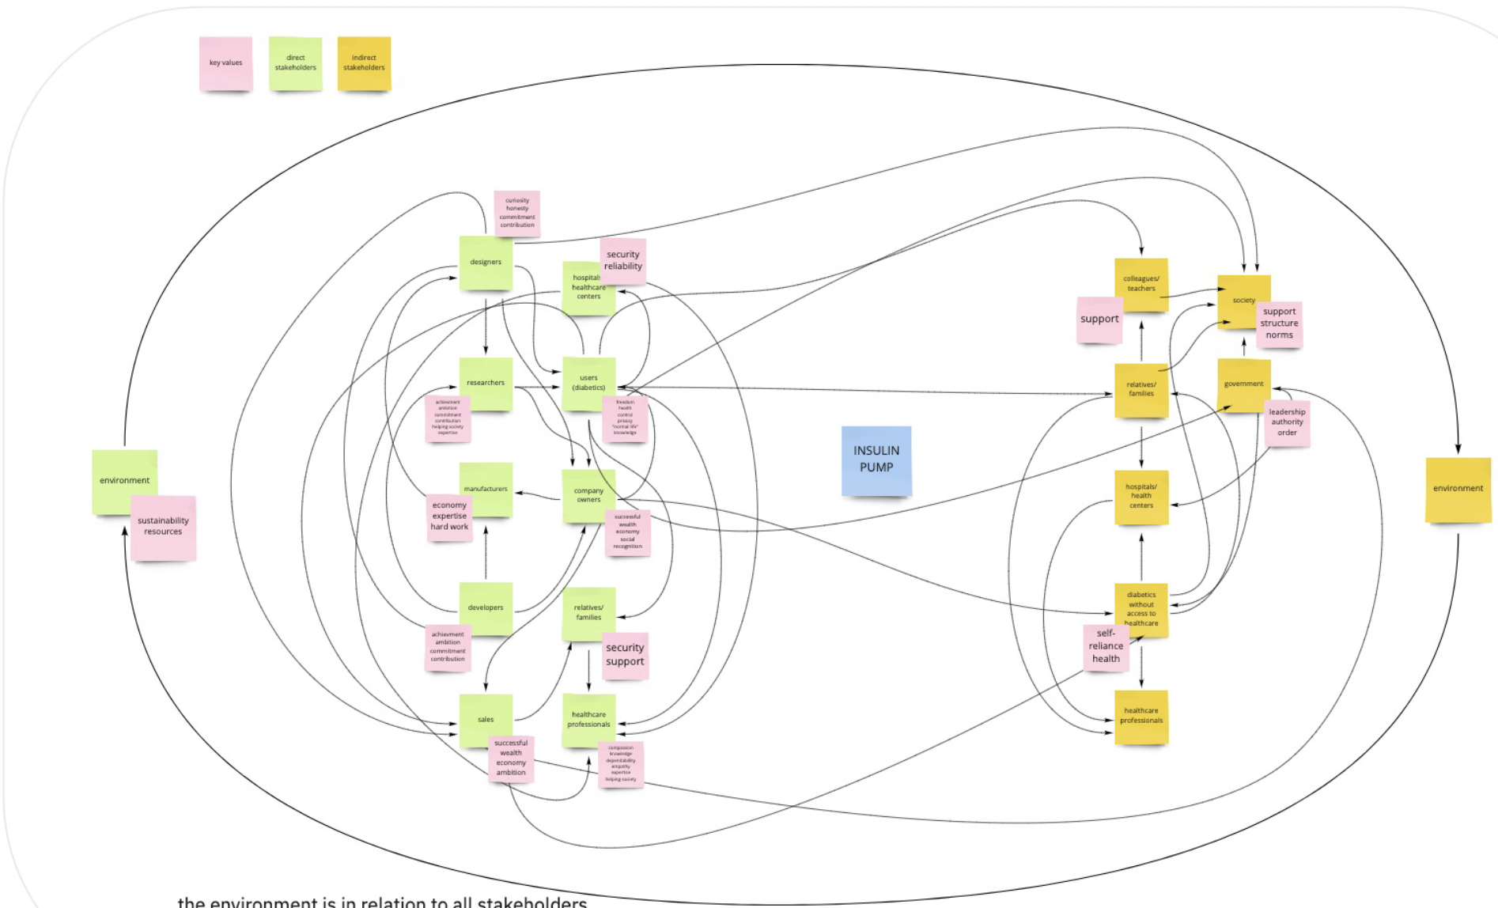
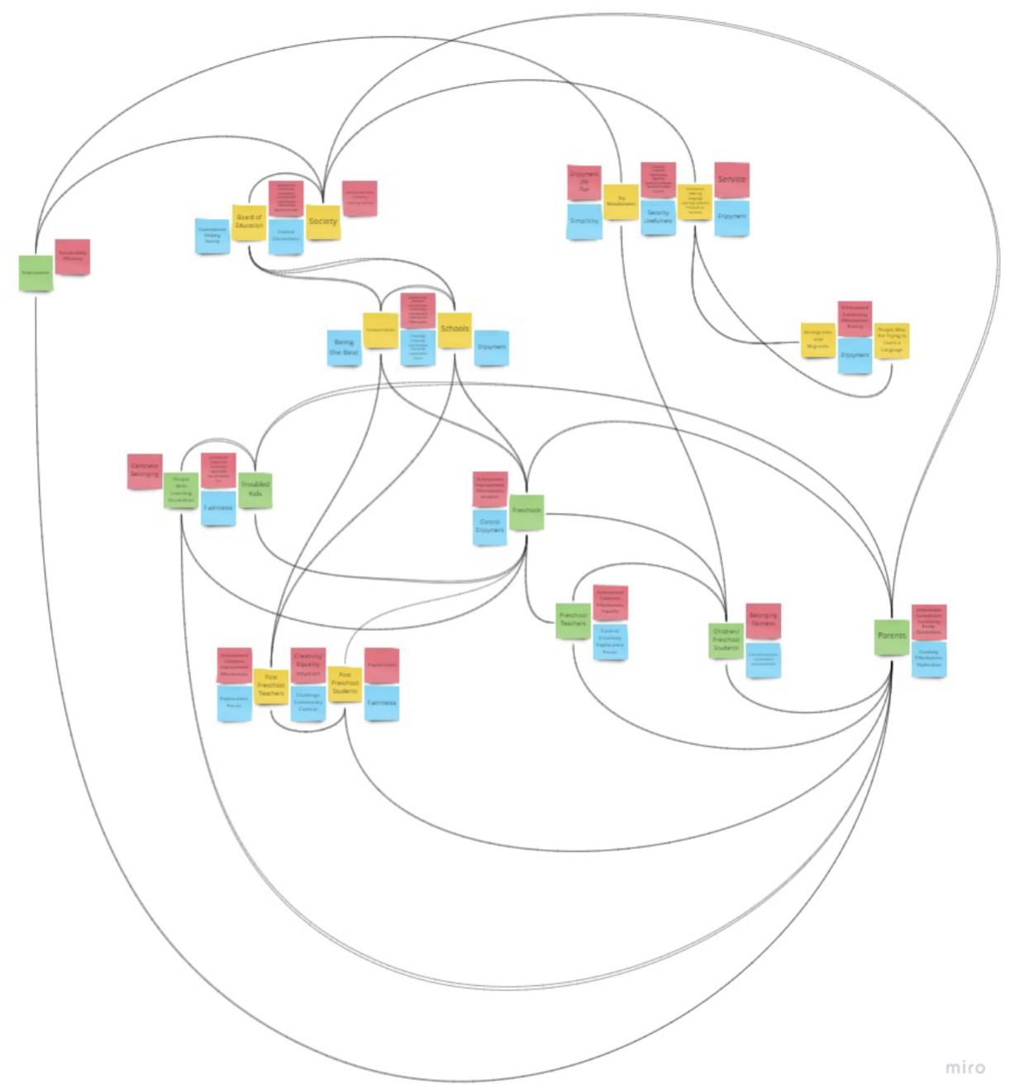
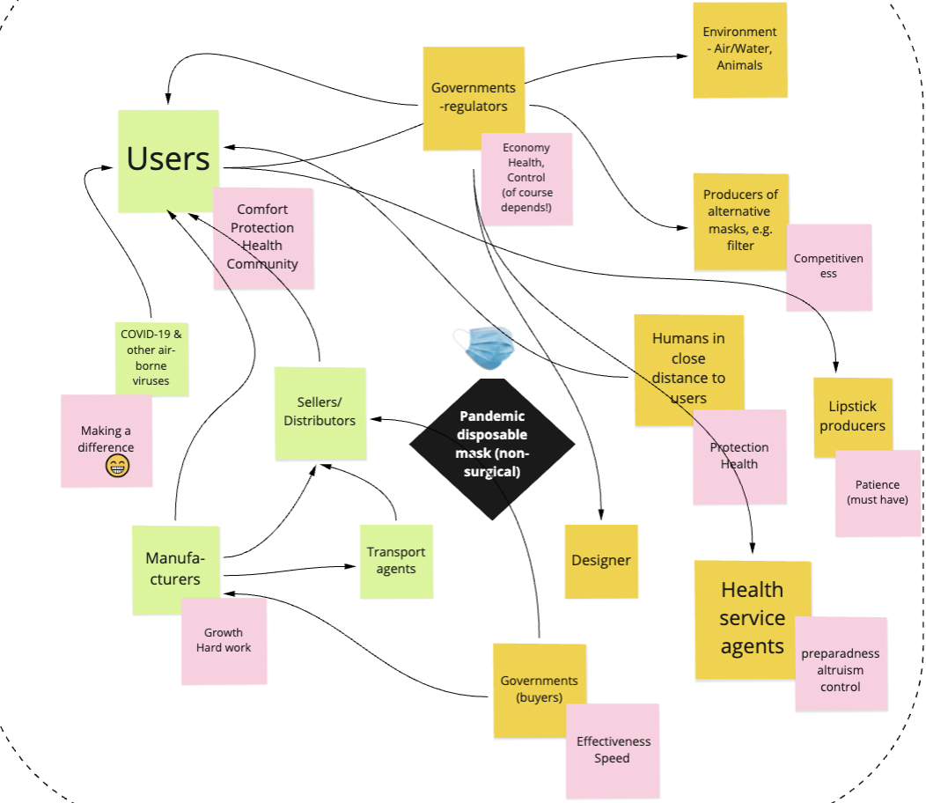
Examples of stakeholder maps:

Slide 16
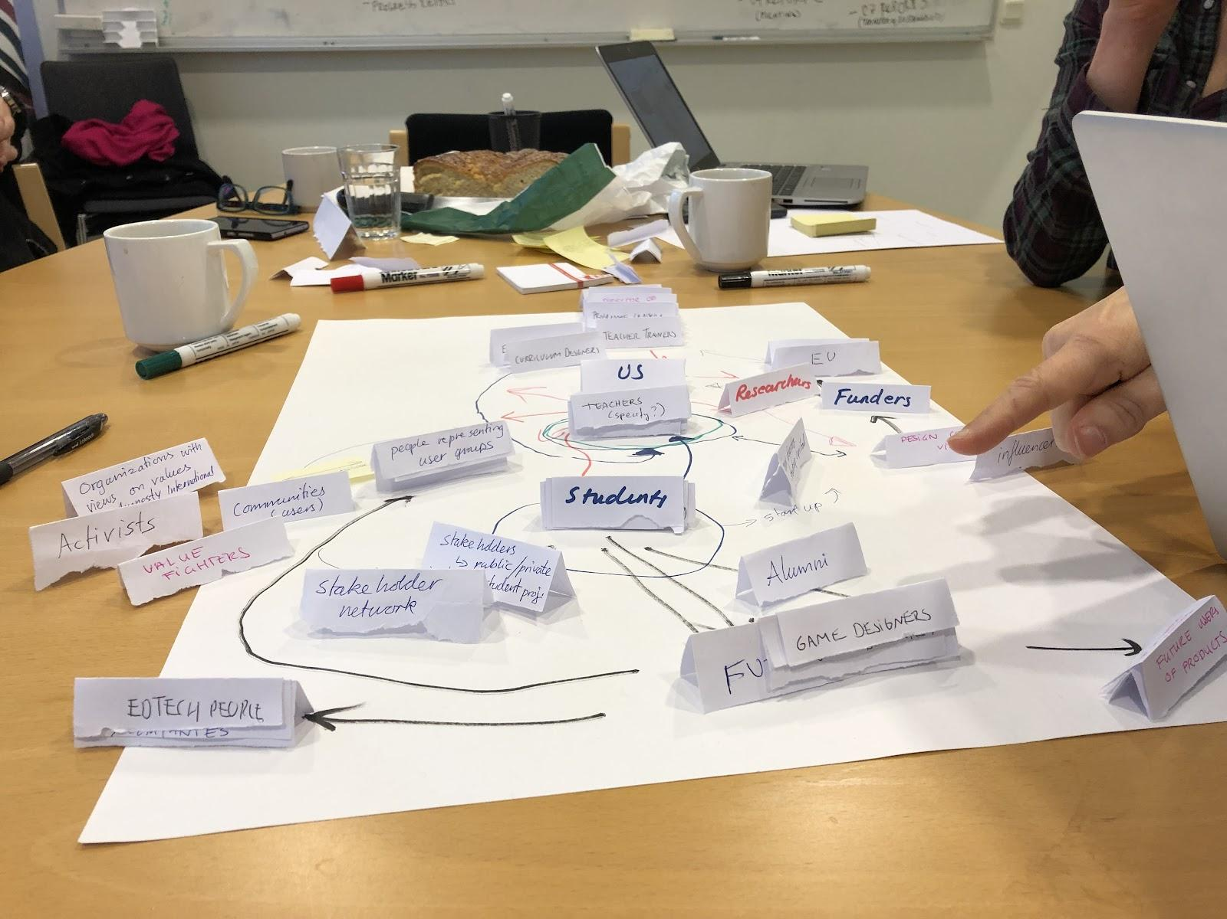

Slide 17
Assignment: Stakeholder mapping
Identify humans and more-than-human stakeholders
that are directly or indirectly implicated by your design.
Part II: Empathise with (30 minutes)
Develop an understanding of the more-than-human stakeholder values and needs.
(This is a start, more research is needed.)
Instructions:
– Select a few more-than-human stakeholders to empathise with.
– For each of the stakeholders, think about their needs and key values (what they find most
important in life).
– Reflect upon what benefits and harms the design might cause for the stakeholders.
– Use the ”Stakeholder analysis” worksheet to document your thoughts.
– Use 30 minutes for the activity.

Slide 18
'How can we learn to listen to the voices of our more-than-human companions, and all the species and parts of nature that cannot speak for themselves, but still are affected by or affect our actions and design choices?'
Questions to discuss:
– How do we learn to understand (empathise with) more-than-human (and human) stakeholder values and needs? What methods to use, what other disciplines and fields to turn to?
– What kind of knowledge needs to be taken into consideration to really care about this more-than-human stakeholder?

Slide 19
This teaching activity was developed as part of the MOVA project co-funded by the European Union. https://mova.uni.mau.se/
Disclaimer: Funded by the European Union. Views and opinions expressed are however those of the author(s) only and do not necessarily reflect those of the European Union or the European Education and Culture Executive Agency (EACEA). Neither the European Union nor EACEA can be held responsible for them.

