Slide 1


More-than-human design process
– ways of drifting with, living with,
designing with

Slide 2
Summary
Student are introduced to different design processes and research through design (RtD). Then they sketch a design process for working with a selection of more-than-human actors in a specific case. Finally, the different design process sketches are shared and discussed.
Learning outcomes
After the teaching activity students should be able to:
Describe different design processes and research through design methods.
Combine research through design methods into a design process that involves more-than-human actors.
Sketch and plan a design process for a specific case that involves more-than-human actors.

Slide 3
Outline/Content
Discussing different design processes
Going into depth with research through design (RtD)
Adding to the RtD model
Sketch a design/development process with MTH perspectives
Group discussions and presentations
Plenum discussion

Slide 4
Key readings
Krogh, P. G., Markussen, T. & Bang, A. L. (2015) Ways of drifting – 5 methods of experimentation in research through design. International Conference on Research into Design (ICoRD), Bangalore, India January 7-9. http://10.1007/978-81-322-2232-3

Slide 5
Discussing different design processes
Examples of well-known design process models are:
Double Diamond by the British Design Council and the extended version called the Systemic Design Framework
Design Thinking model from the Interaction Design Foundation, focusing in users and their needs
Research through Design (RtD) that we will go more into depth with in this lecture

Slide 6
Integrating more-than-human perspectives
When integrating more-than-human perspectives into a design process, it might be challenging to fit these perspectives into design processes that have originally evolved from a collection of user-centred design methods.
Even though the Double Diamond, the Systemic Design Framework, and the Design Thinking models encourage iterative processes, these models are still focused on the development of a product, service or system that will enter people’s everyday lives after development and be used by humans in their everyday lives.
When designing with and for more-than-humans, things are not so simple. Different kinds of expertise need to be accounted for and integrated into the design process, allowing for interdisciplinary methods and processes to be embedded into a design process.

Slide 7
Integrating more-than-human perspectives
Designers might need to consult with experts over several rounds to ensure that knowledge about specific more-than-humans are taking into consideration. Some of these experts could be, but are not limited to:
Biologists, zoologists, botanists
Environmental scientists
Landscape architects, architects, and city planners
Stakeholders that interact with specific more-than-humans regularly such as farmers, fishermen, Indigenous peoples… citizens living near specific more-than-humans that are part of their everyday lives.
If we design with and for technological more-than-humans, engineers, mathematicians, and other people with technical expertise need to be consulted.

Slide 8
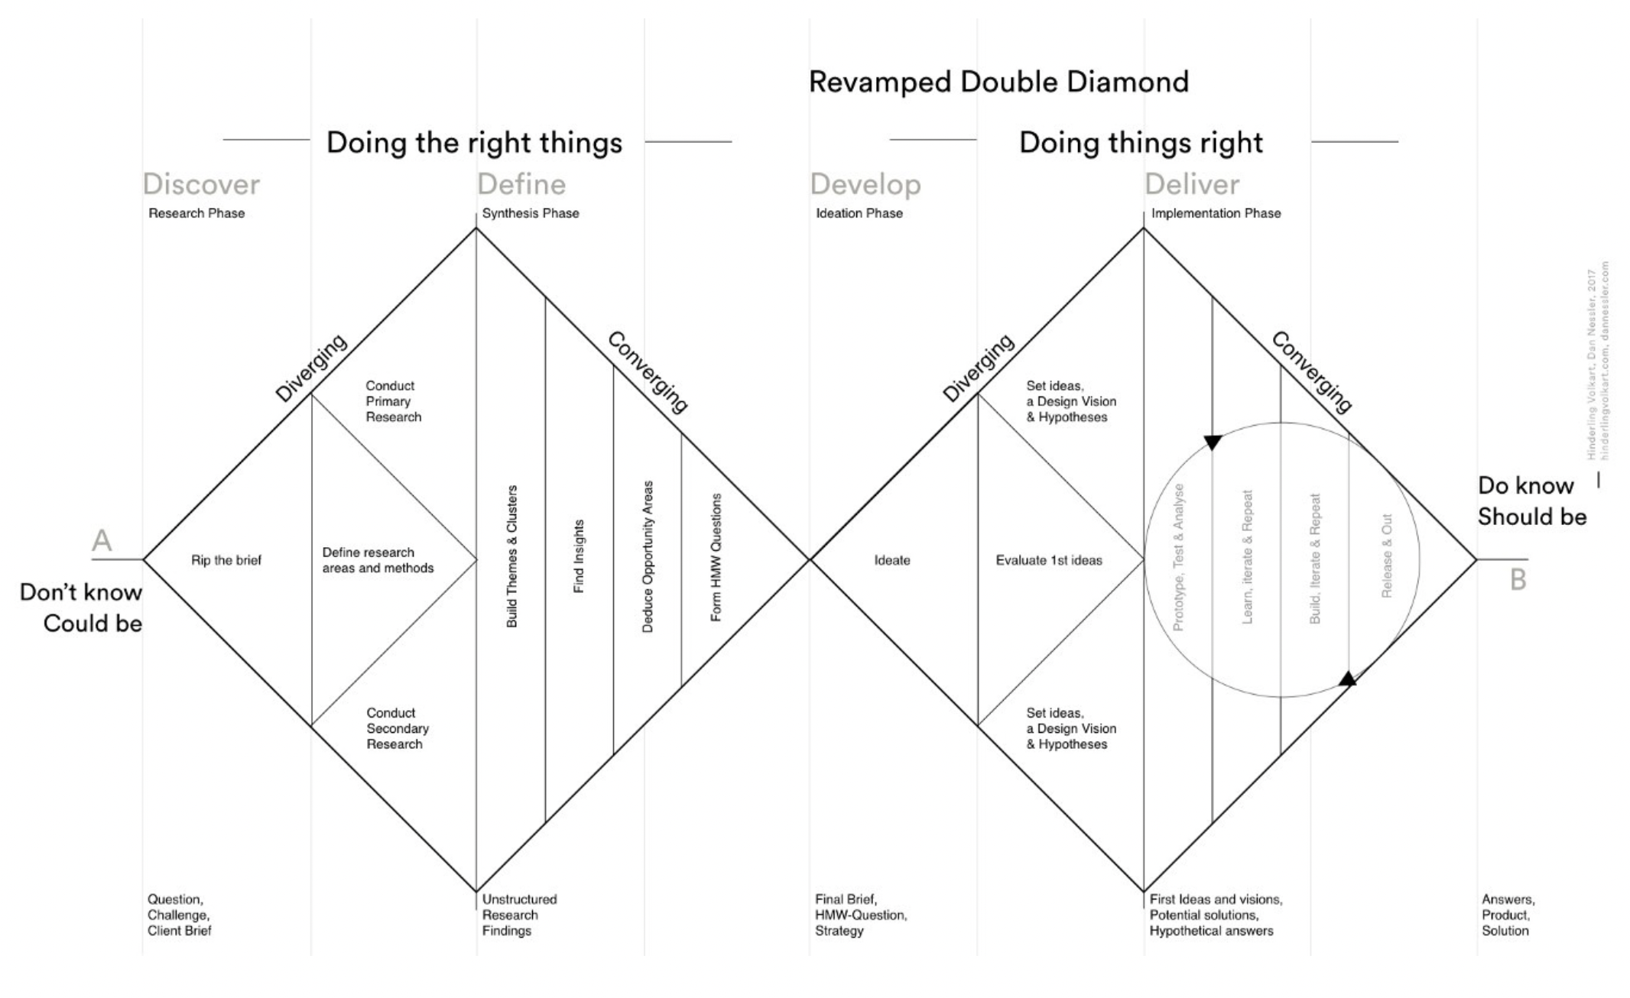
Double Diamond
…

Slide 9
Double Diamond
Characteristic for this model are the four phases: discover, define, develop, deliver.
… but how might we take interdisciplinary perspectives and approaches into account and integrate them with the double diamond? What processes do for example biologists have, and how might they fit into or run in parallel with the double diamond?

Slide 10
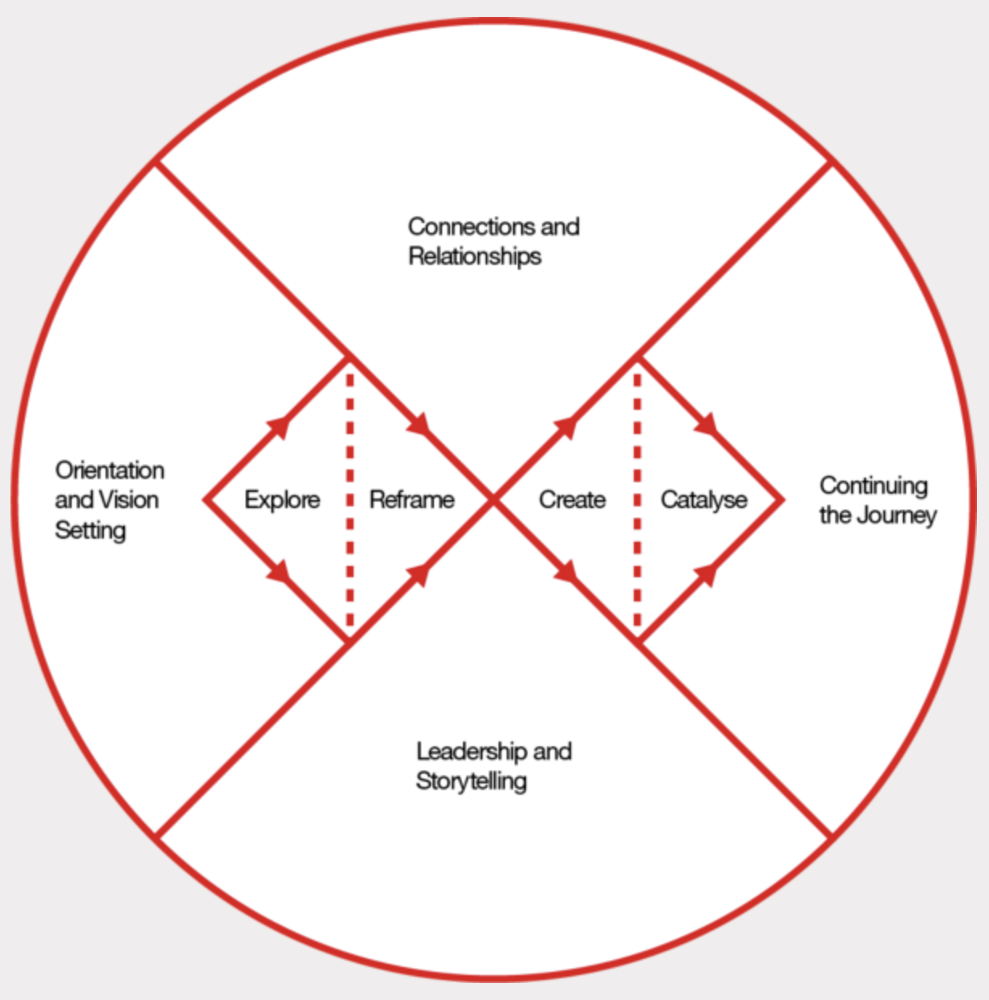
Systemic
Design
Frame-
work
Integrates the
context, and
there is an
opportunity
to continue the
journey …

Slide 11
Systemic Design Framework
Characteristic for this model are the four context areas around a modified version of the double diamond – see more here what all the elements mean. The video on this website explains all the parts: https://www.designcouncil.org.uk/our-resources/systemic-design-framework
Because this model also deals with context, there is an opportunity to consider human entanglements with more-than-humans through what they call "connections and relationships" that need to be considered in the reframe and the create parts of the process.
There is also an opportunity to "continue the journey" which might mean that a design is should not necessarily be finished when it is introduced into an environment with more-than-humans. Perhaps there should be room for "designing with" more-than-humans in ways where they can modify and reconfigure a design over time?

Slide 12
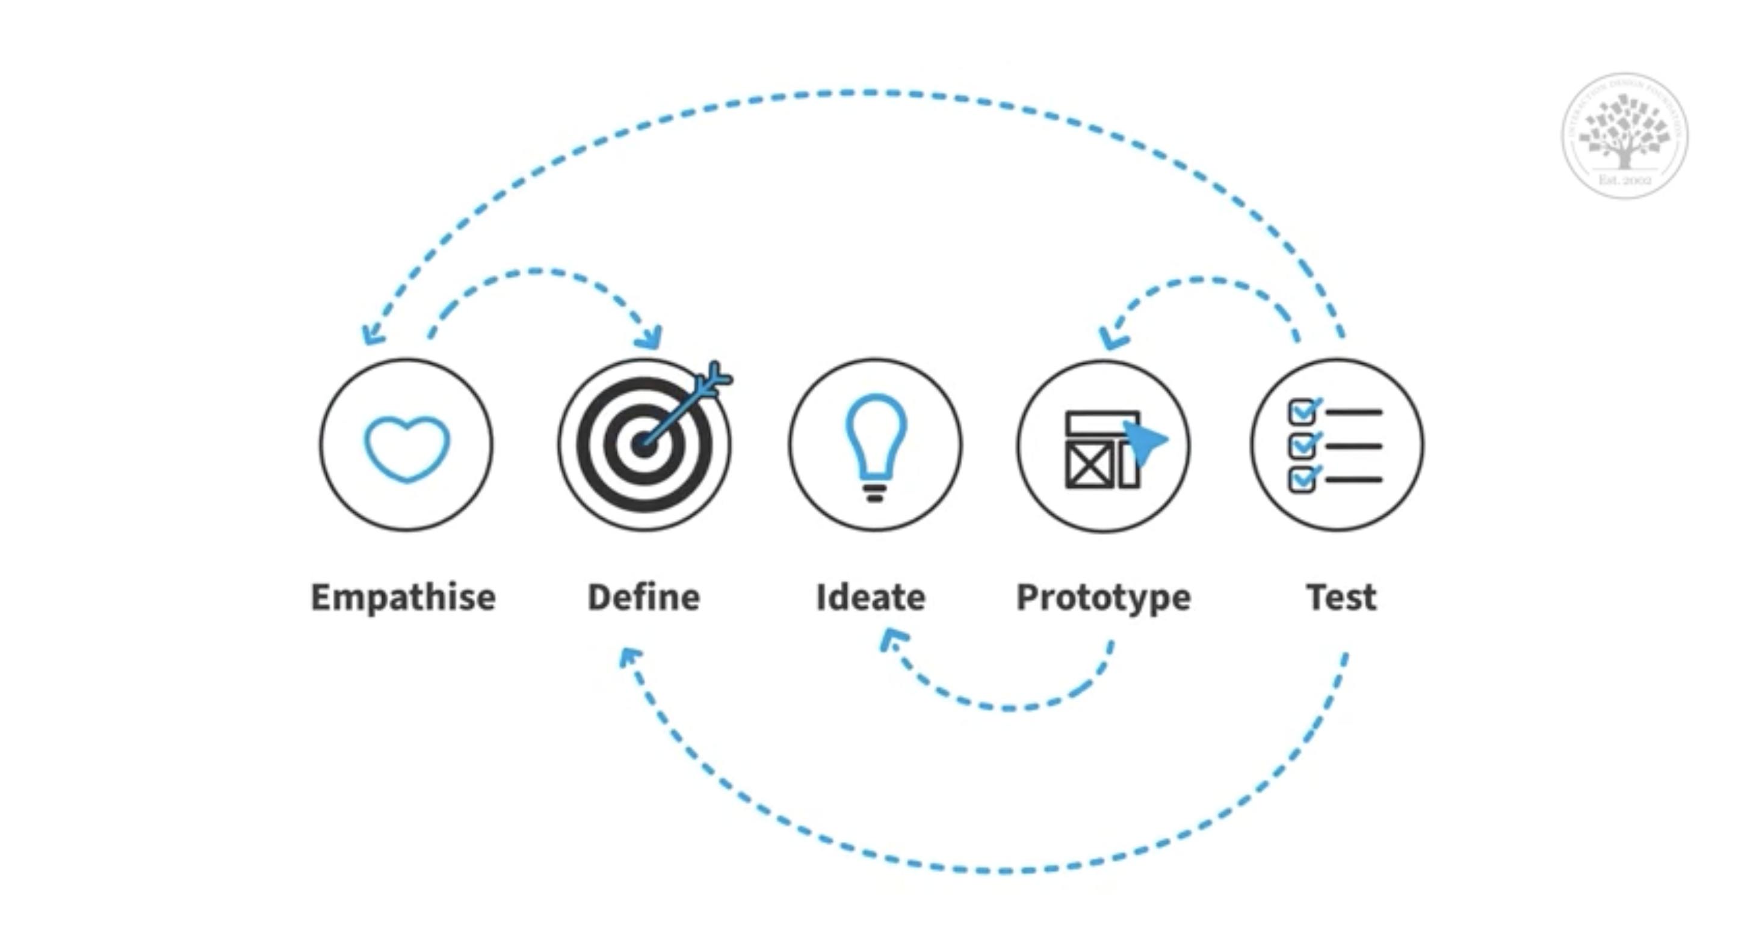
The Design Thinking model

Slide 13
The Design Thinking model – the five steps
Empathize: understand the problem that a design should solve through research. This stage allows designers to set aside their own assumptions and gain insights into the users’ needs.
Define: information is accumulated and analysed. It is synthesized to define the problems that should be solved by a design. The design team formulates problem statements.
Ideate: brainstorming ways of viewing the problem, and alternative ways of solving the problem.
Prototype: identifying the best possible solution to the problem. Experimentation through inexpensive scaled-down, rough versions of the product.
Test: trying solutions out together with users and gather new insights to improve the solutions.

Slide 14
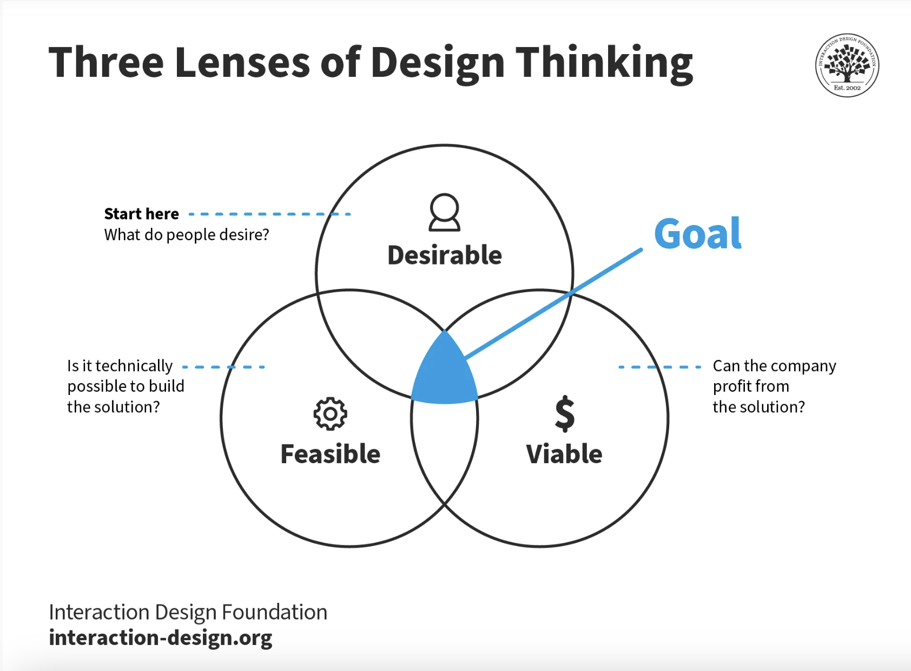
Design
Thinking
Evaluating
if a design
is worth
pursuing
… in relation to
what?

Slide 15
The Design Thinking model
Characteristic for this model are the five phases: emphasize, define, ideate, prototype, test.
This model evaluates if the design is
desirable (by humans): needs, dreams, and behaviours of people. How might we also include behaviours of more-than-humans? And what needs do they have?
feasible (technologically): can the designers implement the solutions? Or do they need help through interdisciplinary collaborations with for example experts from other fields of study? For whom is it worth pursuing? What about environmental feasibility?
viable: a desirable and technically feasible design is not enough. It also needs to generate revenues and profit from the solution. But what does viability mean when considering the more-than-human?

Slide 16
Research Through Design (RtD)
Design experimentations through different methods with associated keywords:
Accumulative: depth, stacking
Comparative: acknowledging complexity
Serial: systematizing local knowledge
Expansive: broadening, extending
Probing: illogical, artistic, impact oriented
They can be used in different phases of a design process, depending on what is deemed relevant.

Slide 17
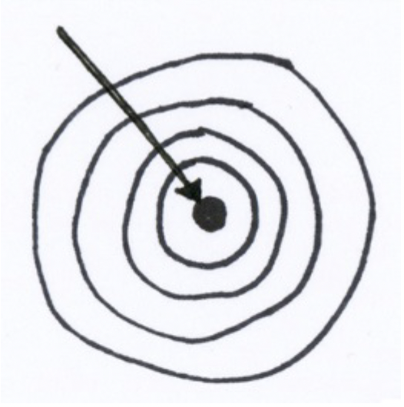
Accumulative
Testing specific parts and wholes of something bigger get an in-depth understanding of the whole. Cognitive qualities are appreciated over contextual appropriateness. Studies might be done in laboratory settings where disturbing elements are excluded for the sake of clarity.
Depth of knowledge on a particular aspect of a whole where knowledge is layered.

Slide 18
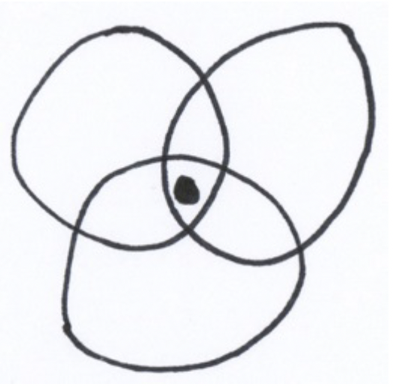
Comparative
To explore areas and aspects not yet dealt with in other experiments and incorporate knowledge from previous experiments or for example other fields of study.
Through experiences, learnings, and insights from a series of design cases, overlapping knowledge can be identified. When working on a new case, knowledge from previous cases can be incorporated.
Keywords: “acknowledging complexity”.

Slide 19
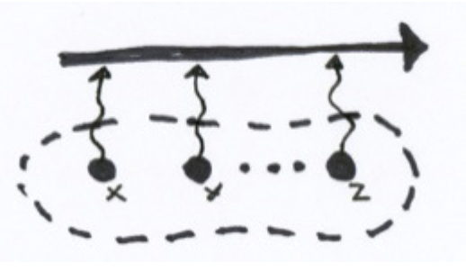
Serial
Complementing the comparative method: insights are gained between design experiments that are performed chronologically. Each experiment is framed by the insights and learnings from the previous experiment.
An object of study is evolved over time according to pragmatic concerns where the designer documents the steps of the process.

Slide 20
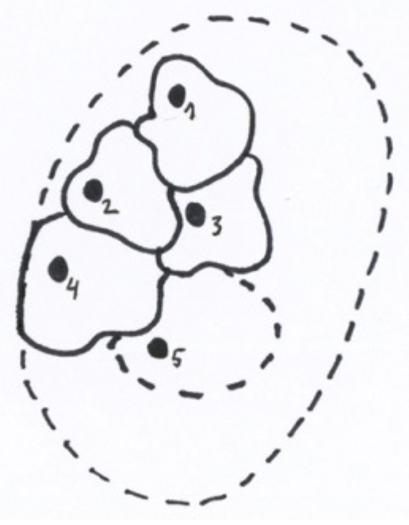
Expansive
Things do not need to happen in succession, as compared to the serial method. The keywords here are “broadening” and “extending” (across several fields of study?). Rather than deepening like with the accumulative method, this methods widens the designer’s perspective.
Objects of concern are extended, and the designer will approach these by continuously developing new aspects, approaches, and techniques in relation to each matter of concern. It is an expansion of what “design engagements” mean.

Slide 21
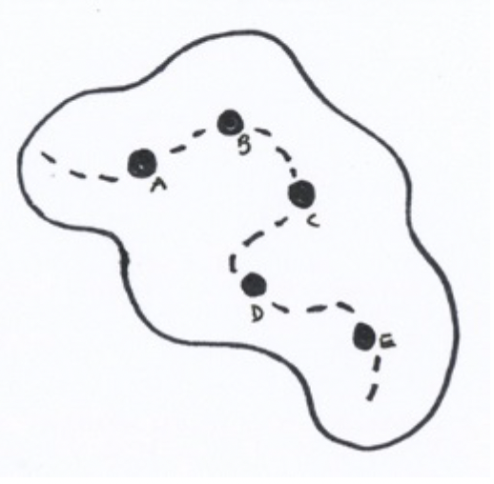
Probing
Exploiting design ideas as they emerge through the process. Moving along with intuition, instead of structuring and planning and following a rational approach. There is a personal motivation to achieve some sort of impact on the world. Keywords are “artistic”, “illogical”, “impact-oriented”.
An almost eclectic way of organizing design settings that might even be self-contradictive, irreductive, pursuing opportunities in the environment experienced by the designer when exposing him/herself to the environment and subject matter.

Slide 22

Spiral / circular (an addition?)
When working with more-than-human stakeholders, could we imagine that we could work in spirals? For example, by following the rhythms of certain things? Moon cycles, tides, seasons, weather patterns, mating cycles, and so on …
Temporality: this means that we need to explore designs across longer periods of time. Learnings about how a design works in entanglement with other more-than-humans in an environment might require us to explore a design throughout several cycles or rhythms of something. The design might in many ways never really be finished, because it is continuously shaped by the environment.

Slide 23
Sketch a design process
The task is now to pick a case to work on. The case should include more-than-humans and more-than-human perspectives. This can be a case that you already work on in a project, or it can be the case that we present to you in the next slide.
Given the different design processes and research through design methods, what could a design process look like and consist of? What kinds of design experiments are needed? Formulate a design brief and then argue for how you think that the design process should be. Also consider which fields of expertise should be involved.
What forms of experiments are relevant when working with a selection of more-than-human stakeholders in a specific context? How should we work? How can we involve a selection of more-than-humans? And what can we learn from them?

Slide 24
Example case
This case is about how citizens in a city might live in sustainable ways together with more-than-humans. It can be anything related to how we might invite trees and plants into the cityscapes and nurture them well, or how we might create spaces for insects and/or birds and/or other wildlife to co-exist with humans in densely populated city areas. What kinds of nature-cultures (Haraway 2016) might citizens collaborate on establishing and being part of? How might they organize themselves in ways where they can live with more-than-humans in ways that might also increase life quality in humans?
Based on this case that is very broad: start with formulating your own design brief that is a sub-area of this wider case. Then sketch the related design process.
Haraway, D. J. (2016). Staying with the Trouble – Making Kin in the Chthulucene. Duke University Press.

Slide 25
Plenum discussion
We round up with a plenum discussion where all groups get to present their sketches of the different design processes. We comment on each other’s work.
The discussion evolves around these topics:
Quick introduction to the design briefs that each group created
Which kinds of expertise are needed?
What combination of research through design methods do you plan to use?
What do the phases of your design process consist of? What does it look like?

Slide 26
References
Design Council. (11/27-2024) The double diamond. The British Design Council. https://www.designcouncil.org.uk/our-resources/the-double-diamond
Design Council. (11/27-2024) The systemic design framework. The British Design Council. https://www.designcouncil.org.uk/our-resources/systemic-design-framework
Haraway, D. J. (2016). Staying with the Trouble – Making Kin in the Chthulucene. Duke University Press.
Krogh, P. G., Markussen, T. & Bang, A. L. (2015) Ways of drifting – 5 methods of experimentation in research through design. International Conference on Research into Design (ICoRD), Bangalore, India January 7-9 2015. https://doi.org/10.1007/978-81-322-2232-3_4
The Interaction Design Foundation. (11/27-2024) What is design thinking (DT)?. The Interaction Design Foundation. https://www.interaction-design.org/literature/topics/design-thinking?srsltid=AfmBOoo08w-loFJxfeg3OvGI7Rr9uA8agETkES0C3ph8_OFjEOGQ2mbN

Slide 27
This teaching activity was developed as part of the MOVA project co-funded by the European Union. https://mova.uni.mau.se/
Disclaimer: Funded by the European Union. Views and opinions expressed are however those of the author(s) only and do not necessarily reflect those of the European Union or the European Education and Culture Executive Agency (EACEA). Neither the European Union nor EACEA can be held responsible for them.

