Slide 1


Unmaking human-centered design

Slide 2
Summary and Learning outcomes
Summary
Through this teaching activity, students will learn to broaden their views, from focusing on humans (which is the core of human-centered design) to taking a more-than-human perspective. In this way, they are supported in working from "old practices" towards a new interpretation of the field of more-than-human-centered design.
Learning outcomes
After this activity students should be able to:
Recognise the interrelationships between human and non-human elements in human-computer design.
Engage in reflective discussions to evaluate the ethical, social, and environmental impacts of their design choices,
Propose strategies for incorporating more-than-human considerations into future design projects.

Slide 3
Outline/Content
What is human-centered design?
What is more-than-human centered design?
How can we unmake human-centered design?
How can we make more-than-human centered design?

Slide 4
Key readings
Giaccardi, E., & Redström, J. (2020). Technology and More-Than-Human Design. Design Issues, 36, 33-44. https://doi.org/10.1162/desi_a_00612.
Tarcan, B. (2022). Making-with the environment through more-than-human design. Proceedings of DRS. https://doi.org/10.21606/drs.2022.347.
Sabie, S., Song, K. W., Parikh, T. S., Jackson, S., Paulos, E., Lindström, K., Ståhl, Å., Sabie, D., Andersen, K., & Wakkary, R. (2022). Unmaking@CHI: Concretizing the material and epistemological practices of unmaking in HCI. CHI Conference on Human Factors in Computing Systems Extended Abstracts. https://doi.org/10.1145/3491101.3503721

Slide 5
human-centered design
designing solutions that meet the needs, preferences, and behaviors of humans

Slide 6
More-than-human-centered design
designing solutions that meet the needs, preferences, and behaviors of humans and impacts on non-human actors, such as animals, plants, ecosystems

Slide 7
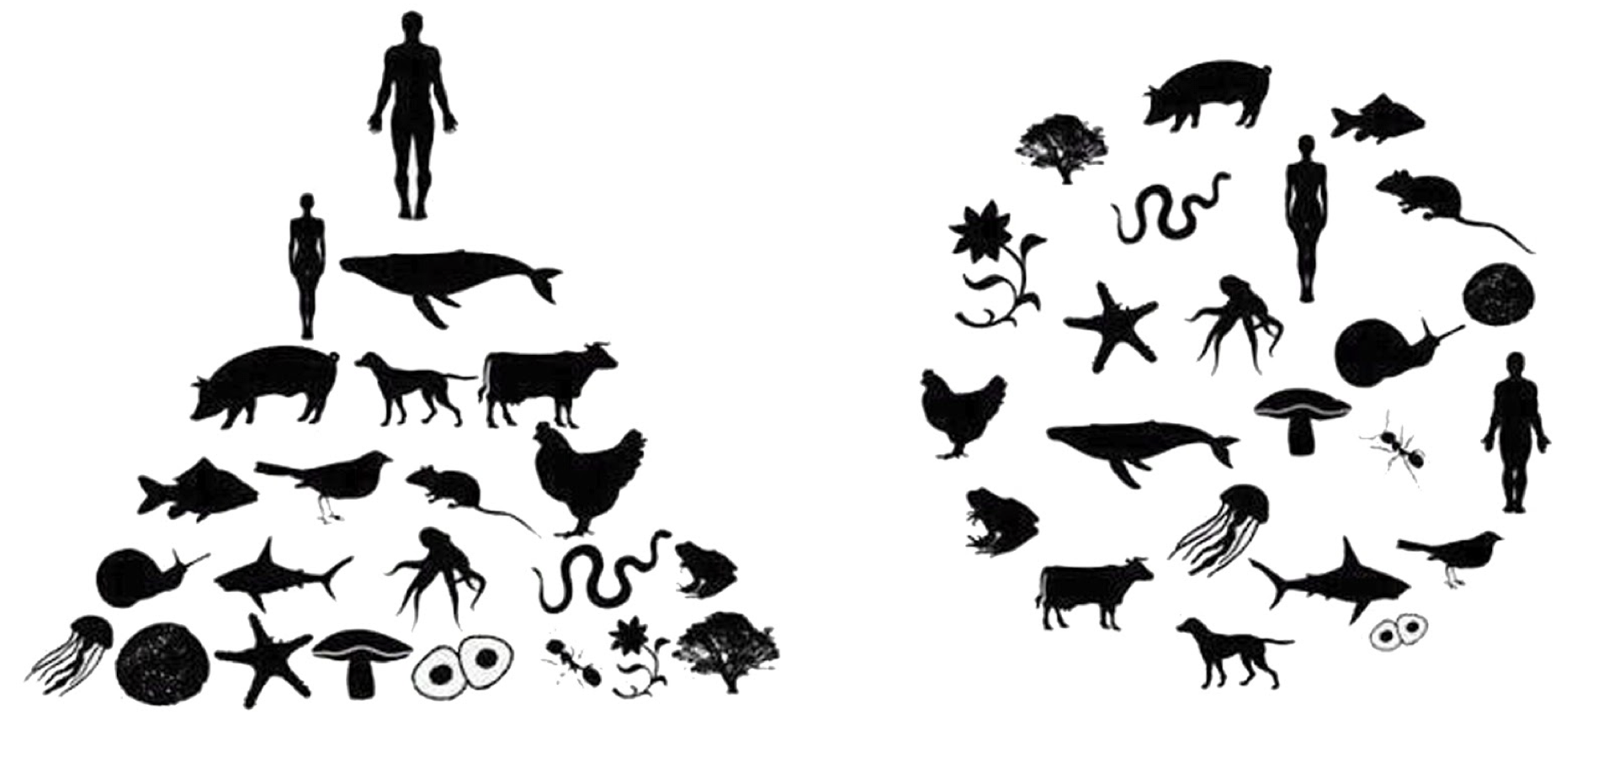
recognizing the interconnectedness of humans with the broader environment and creating solutions that are not only beneficial for humans but also considerate of the well-being and sustainability of other species

Slide 8
HOW?

Slide 9
While design is generally about making and
developing new things, the opposite process of
unmaking something that already exists
can enhance a critical reflection on existing
things to reveal and consider crucial design
challenges with socio-ecological
consequences.

Slide 10
Unmaking
Challenge conventional human-centered design narratives in Human-Centered Design (HCD) and Human-Computer Interaction (HCI) through critical reflection and collaborative exploration of non-human perspectives, using collages.

Slide 11
Unmaking human-centered design

Slide 12

Unmake
1
Individually disassemble the design magazines or other
design or HCI literature provided. Cut out images, text,
and any other pieces of relevant content that signals
human-centered design perspectives.
15 min

Slide 13
Making
more-than-human-centered design

Slide 14
Make
2
Use the materials collected to create a collage representing
more-than-human topics in design/HCI together with peers
(group of 3-5). Discuss individual findings, thoughts and
perspectives on human-centered design vs. more-than-human
design. Arrange, and paste the collected materials onto a
shared poster creatively to create an image of more-than
human design, considering how these cutout pieces interact
and contribute to their overall message.
20 min

Slide 15
Reflecting discussion
3
Reflect in class on the collages (e.g., What story does it tell?)
and the broader implications of more-than-human
considerations in design. Collect current efforts, practices, and
discourses on more-than-human topics in design.
25 min

Slide 16
This teaching activity was developed as part of the MOVA project co-funded by the European Union. https://mova.uni.mau.se/
Disclaimer: Funded by the European Union. Views and opinions expressed are however those of the author(s) only and do not necessarily reflect those of the European Union or the European Education and Culture Executive Agency (EACEA). Neither the European Union nor EACEA can be held responsible for them.

